Slide 1
PCE(%)
FF(%)
(a)
(d)
Nₜ of Cs₃Bi₂I₉ (cm⁻³)
J_{sc}(mA/cm²)
Nₜ of Cs₃Bi₂I₉ (cm⁻³)
Nₜ of MASnI₃ (cm⁻³)
Nₜ of MASnI₃ (cm⁻³)
(b)
(c)
V_{oc}(V)
Nₜ of Cs₃Bi₂I₉ (cm⁻³)
Nₜ of Cs₃Bi₂I₉ (cm⁻³)
Nₜ of MASnI₃ (cm⁻³)
Nₜ of MASnI₃ (cm⁻³)

Slide 2
PCE(%)
FF(%)
(a)
(d)
V_{oc}(V)
J_{sc}(mA/cm²)
Cs₃Bi₂I₉ Thickness(µm)
Cs₃Bi₂I₉ Thickness(µm)
MASnI₃ Thickness(µm)
MASnI₃ Thickness(µm)
(b)
(c)
Cs₃Bi₂I₉ Thickness(µm)
Cs₃Bi₂I₉ Thickness(µm)
MASnI₃ Thickness(µm)
MASnI₃ Thickness(µm)
v

Slide 3
(a)
(d)
PCE(%)
MASnI₃ / Cs₂TiBr₆ interface
MASnI₃ / Cs₂TiBr₆ interface
Cs₃Bi₂I₉ / MASnI₃ interface
FF(%)
Cs₃Bi₂I₉ / MASnI₃ interface
V_{oc}(V)
(c)
(b)
(c) Jsc(Jsc(mA/cm²) mA/cm²)
MASnI₃ / Cs₂TiBr₆ interface
MASnI₃ / Cs₂TiBr₆ interface
J_{sc}(mA/cm²)
Cs₃Bi₂I₉ / MASnI₃ interface
Cs₃Bi₂I₉ / MASnI₃ interface

Slide 4
PCE(%)
(f)
V_{oc}(V)
(e)
Thickness of Cs₃Bi₂I₉(µm)
Thickness of Cs₃Bi₂I₉(µm)
Thickness of Cs₂TiBr₆(µm)
Thickness of MASnI₃(µm)
Thickness of Cs₂TiBr₆(µm)
Thickness of MASnI₃(µm)
(g)
J_{sc}(mA/cm²)
(h)
FF(%)
Thickness of Cs₃Bi₂I₉(µm)
Thickness of Cs₃Bi₂I₉(µm)
Thickness of Cs₂TiBr₆(µm)
Thickness of MASnI₃(µm)
Thickness of Cs₂TiBr₆(µm)
Thickness of MASnI₃(µm)

Slide 5
PCE(%)
FF(%)
N_{A} of MASnI₃ (cm⁻³)
NA of MASnI₃ (cm⁻³)
N_{A} of Cs₃Bi₂I₉ (cm⁻³)
N_{A} of MASnI₃ (cm⁻³)
NA of MASnI₃ (cm⁻³)
J_{sc}(mA/cm²)
N_{A} of Cs₃Bi₂I₉ (cm⁻³)
V_{oc}(V)
N_{A}of Cs₃Bi₂I₉ (cm⁻³)
N_{A} of Cs₃Bi₂I₉ (cm⁻³)

Slide 6
V_{oc}(V)
(e)
(f)
J_{sc} (mA/cm²)
FF(%)
N_{A} of Cs₃Bi₂I₉ (cm⁻³)
N_{A} of Cs₃Bi₂I₉ (cm⁻³)
PCE(%)
N_{A}of MASnI₃ (cm⁻³)
N_{A} of MASnI₃ (cm⁻³)
N_{D} of Cs₂TiBr₆ (cm⁻³)
Nₐ of MASnI₃ (cm⁻³)
N_{D} of Cs₂TiBr₆ (cm⁻³)
(g)
(h)
NA of Cs₃Bi₂I₉ (cm⁻³)
NA of Cs₃Bi₂I₉ (cm⁻³)
N_{A}of MASnI₃ (cm⁻³)
N_{A} of MASnI₃ (cm⁻³)
N_{D}of Cs₂TiBr₆ (cm⁻³)
N_{D} of Cs₂TiBr₆ (cm⁻³)

Slide 7
(e)
PCE(%)
(f )
V_{oc}(V)
Nₜ of Cs₃Bi₂I₉ (cm⁻³)
Nₜ of Cs₃Bi₂I₉ (cm⁻³)
Nₜ of Cs₂TiBr₆ (cm⁻³)
Nₜ of MASnI₃ (cm⁻³)
Nₜ of MASnI₃ (cm⁻³)
J_{sc}(mA/cm²)
Nₜ of Cs₂TiBr₆ (cm⁻³)
FF(%)
(g)
(h)
Nₜ of Cs₃Bi₂I₉ (cm⁻³)
Nₜ of Cs₃Bi₂I₉ (cm⁻³)
Nₜ of MASnI₃ (cm⁻³)
Nₜ of MASnI₃ (cm⁻³)
Nₜ of Cs₂TiBr₆ (cm⁻³)
Nₜ of Cs₂TiBr₆ (cm⁻³)

Slide 8
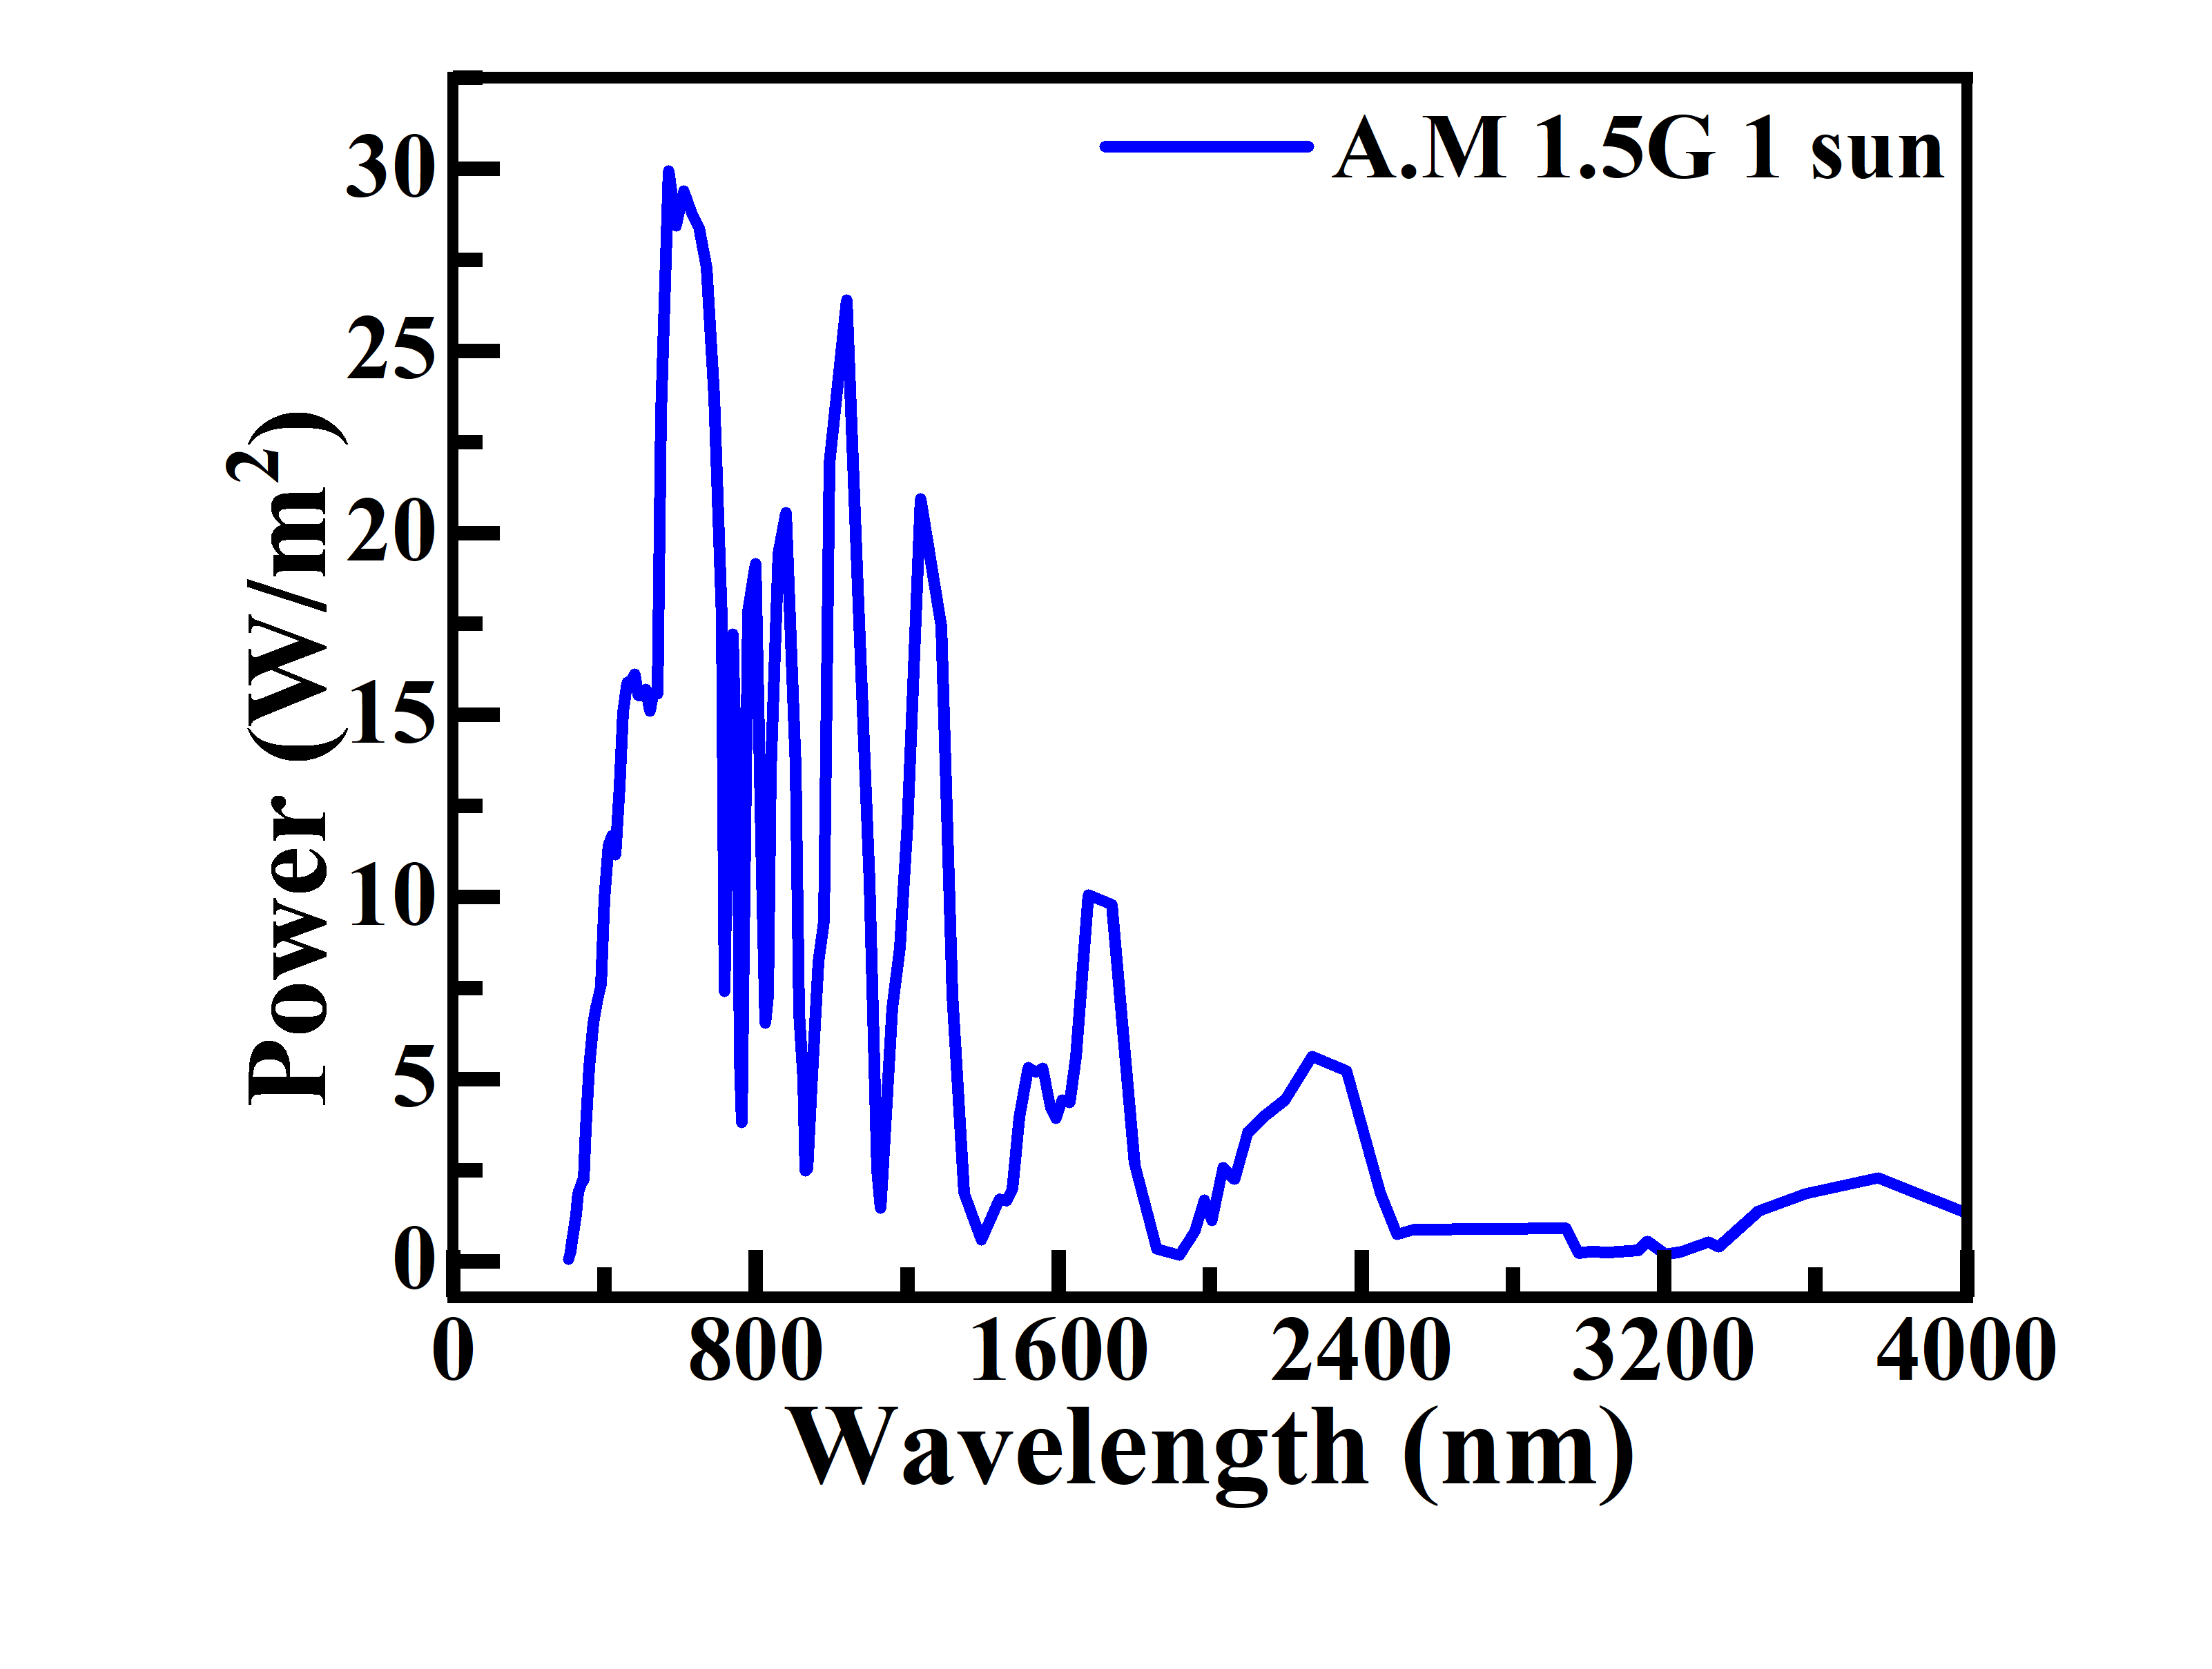
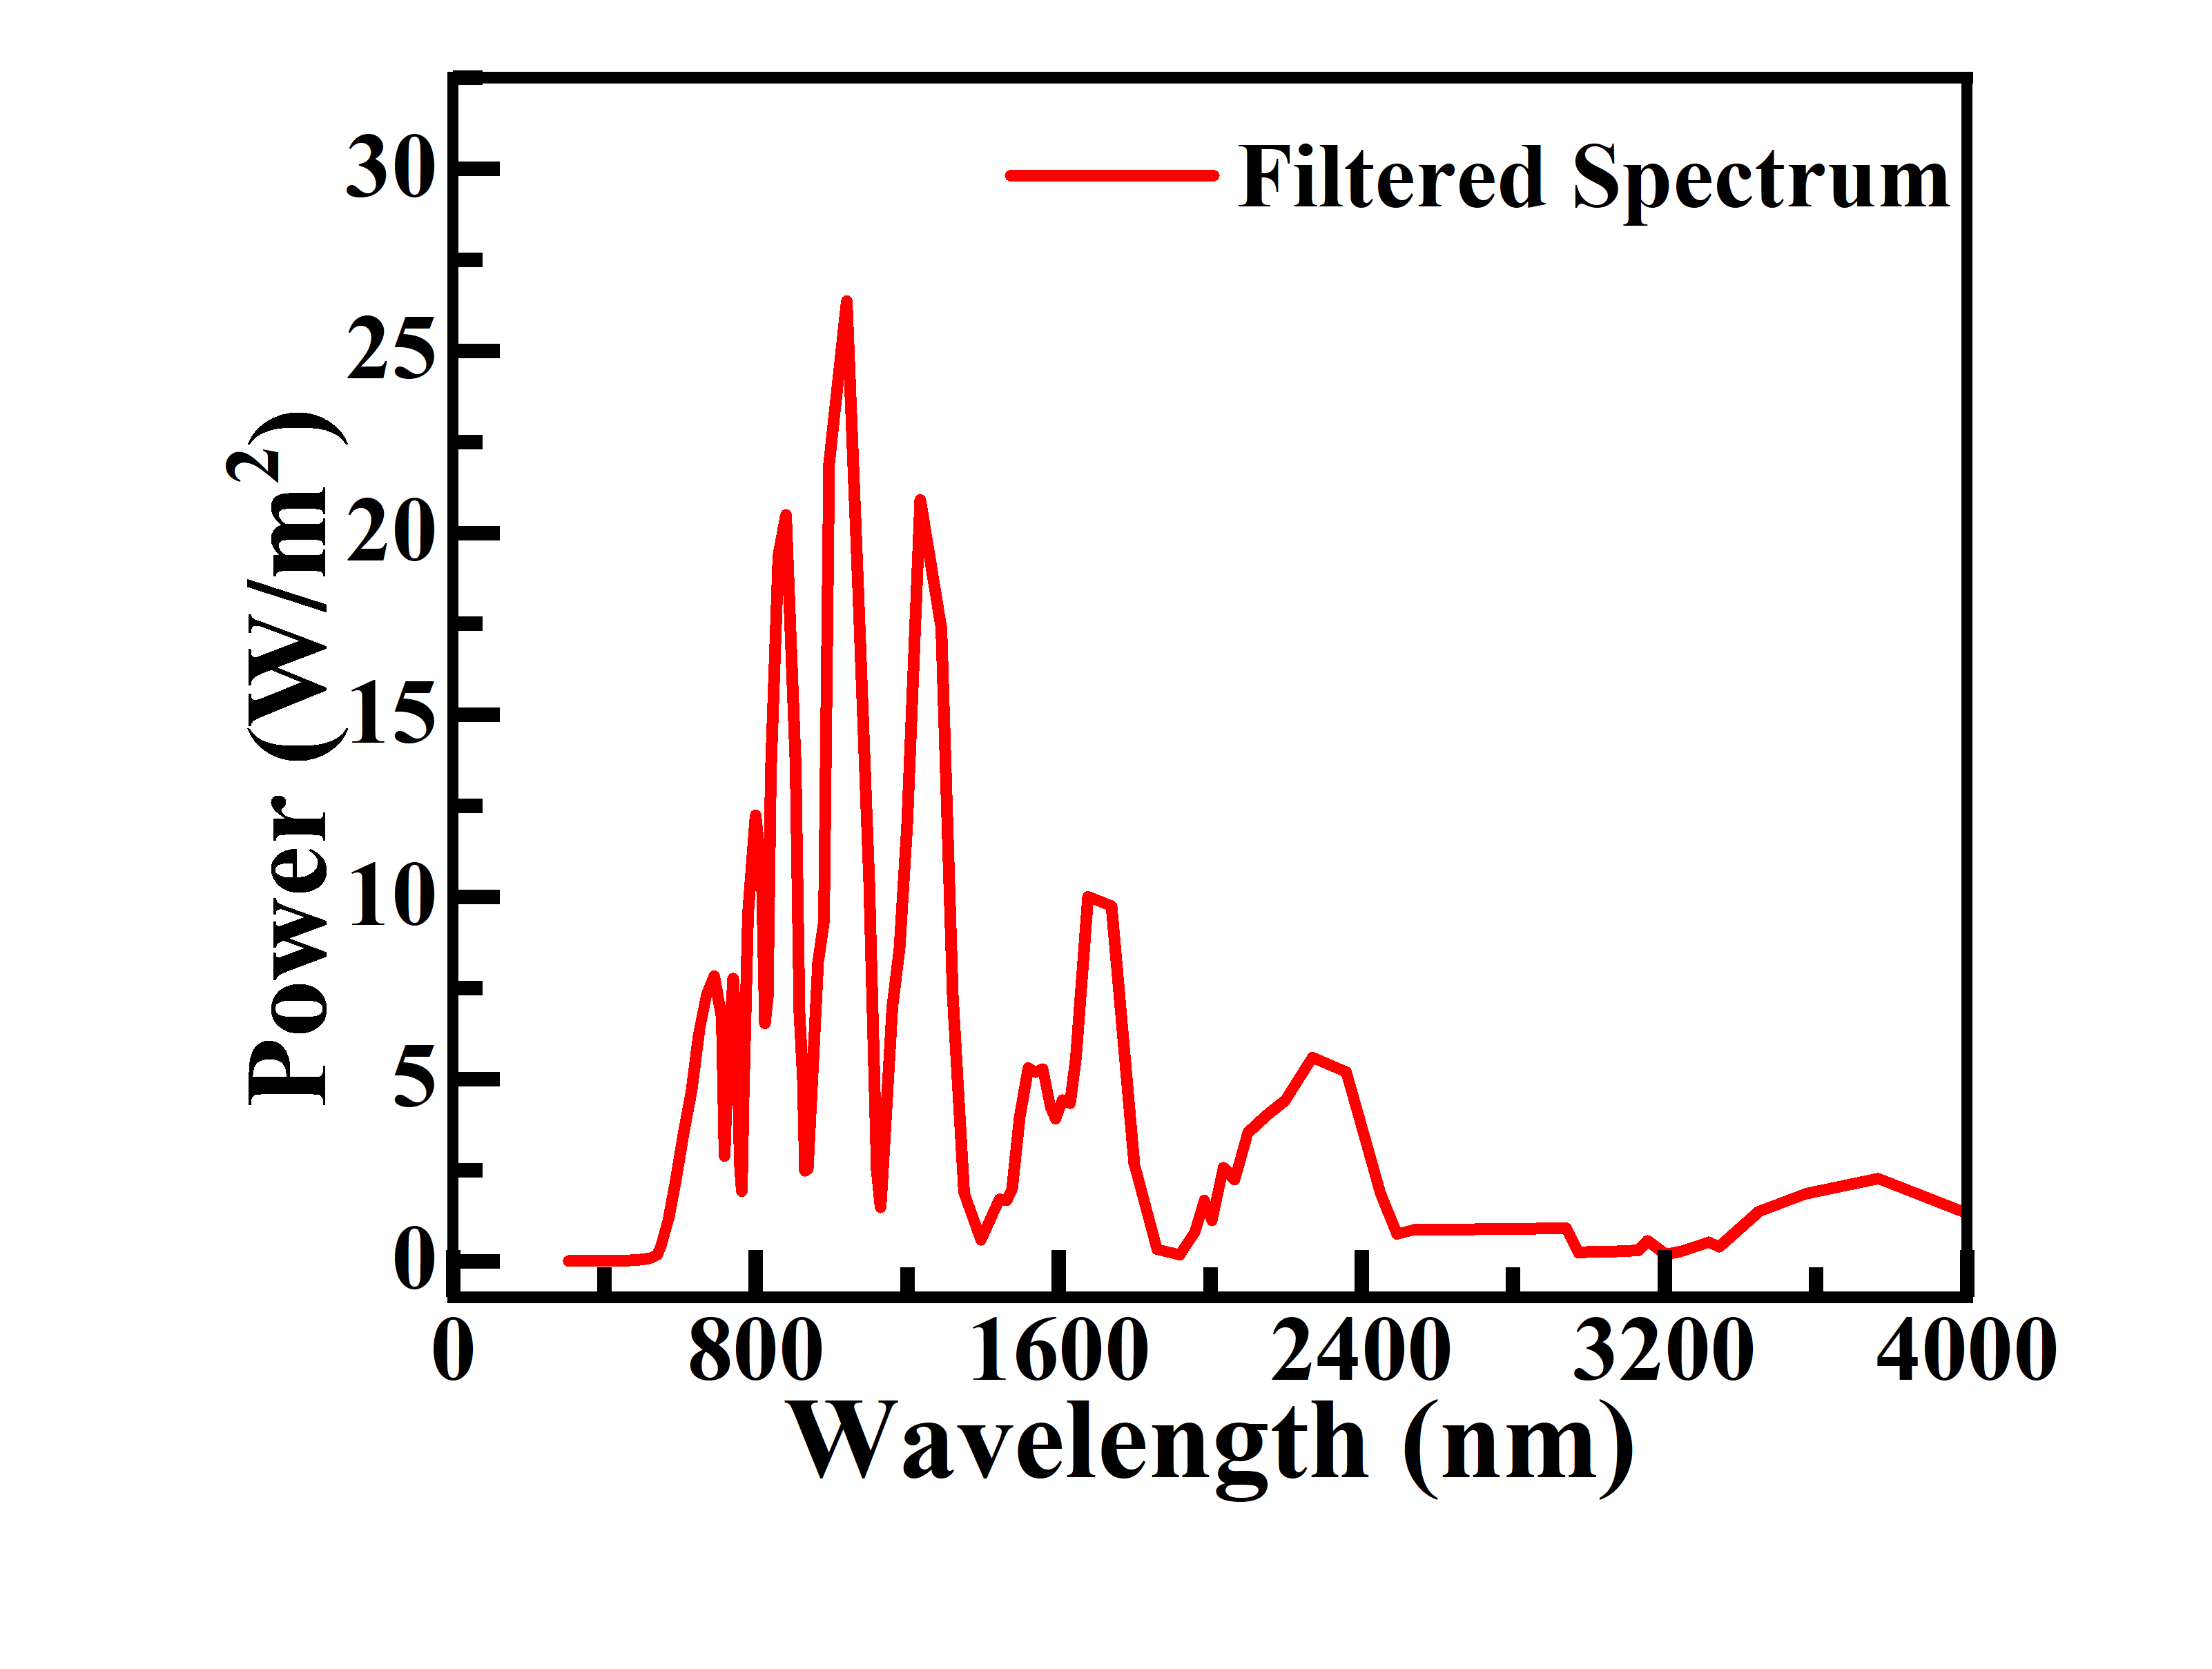
Light
Al
FTO
Cs₂TiBr₆
Top sub-cell
MASnI₃
Cs₃Bi₂I₉
Filtered Light
Load
Recombination Layer
ZnO:Al
i-ZnO
Bottom sub-cell
CdS
CZTSSe
Au

Slide 9
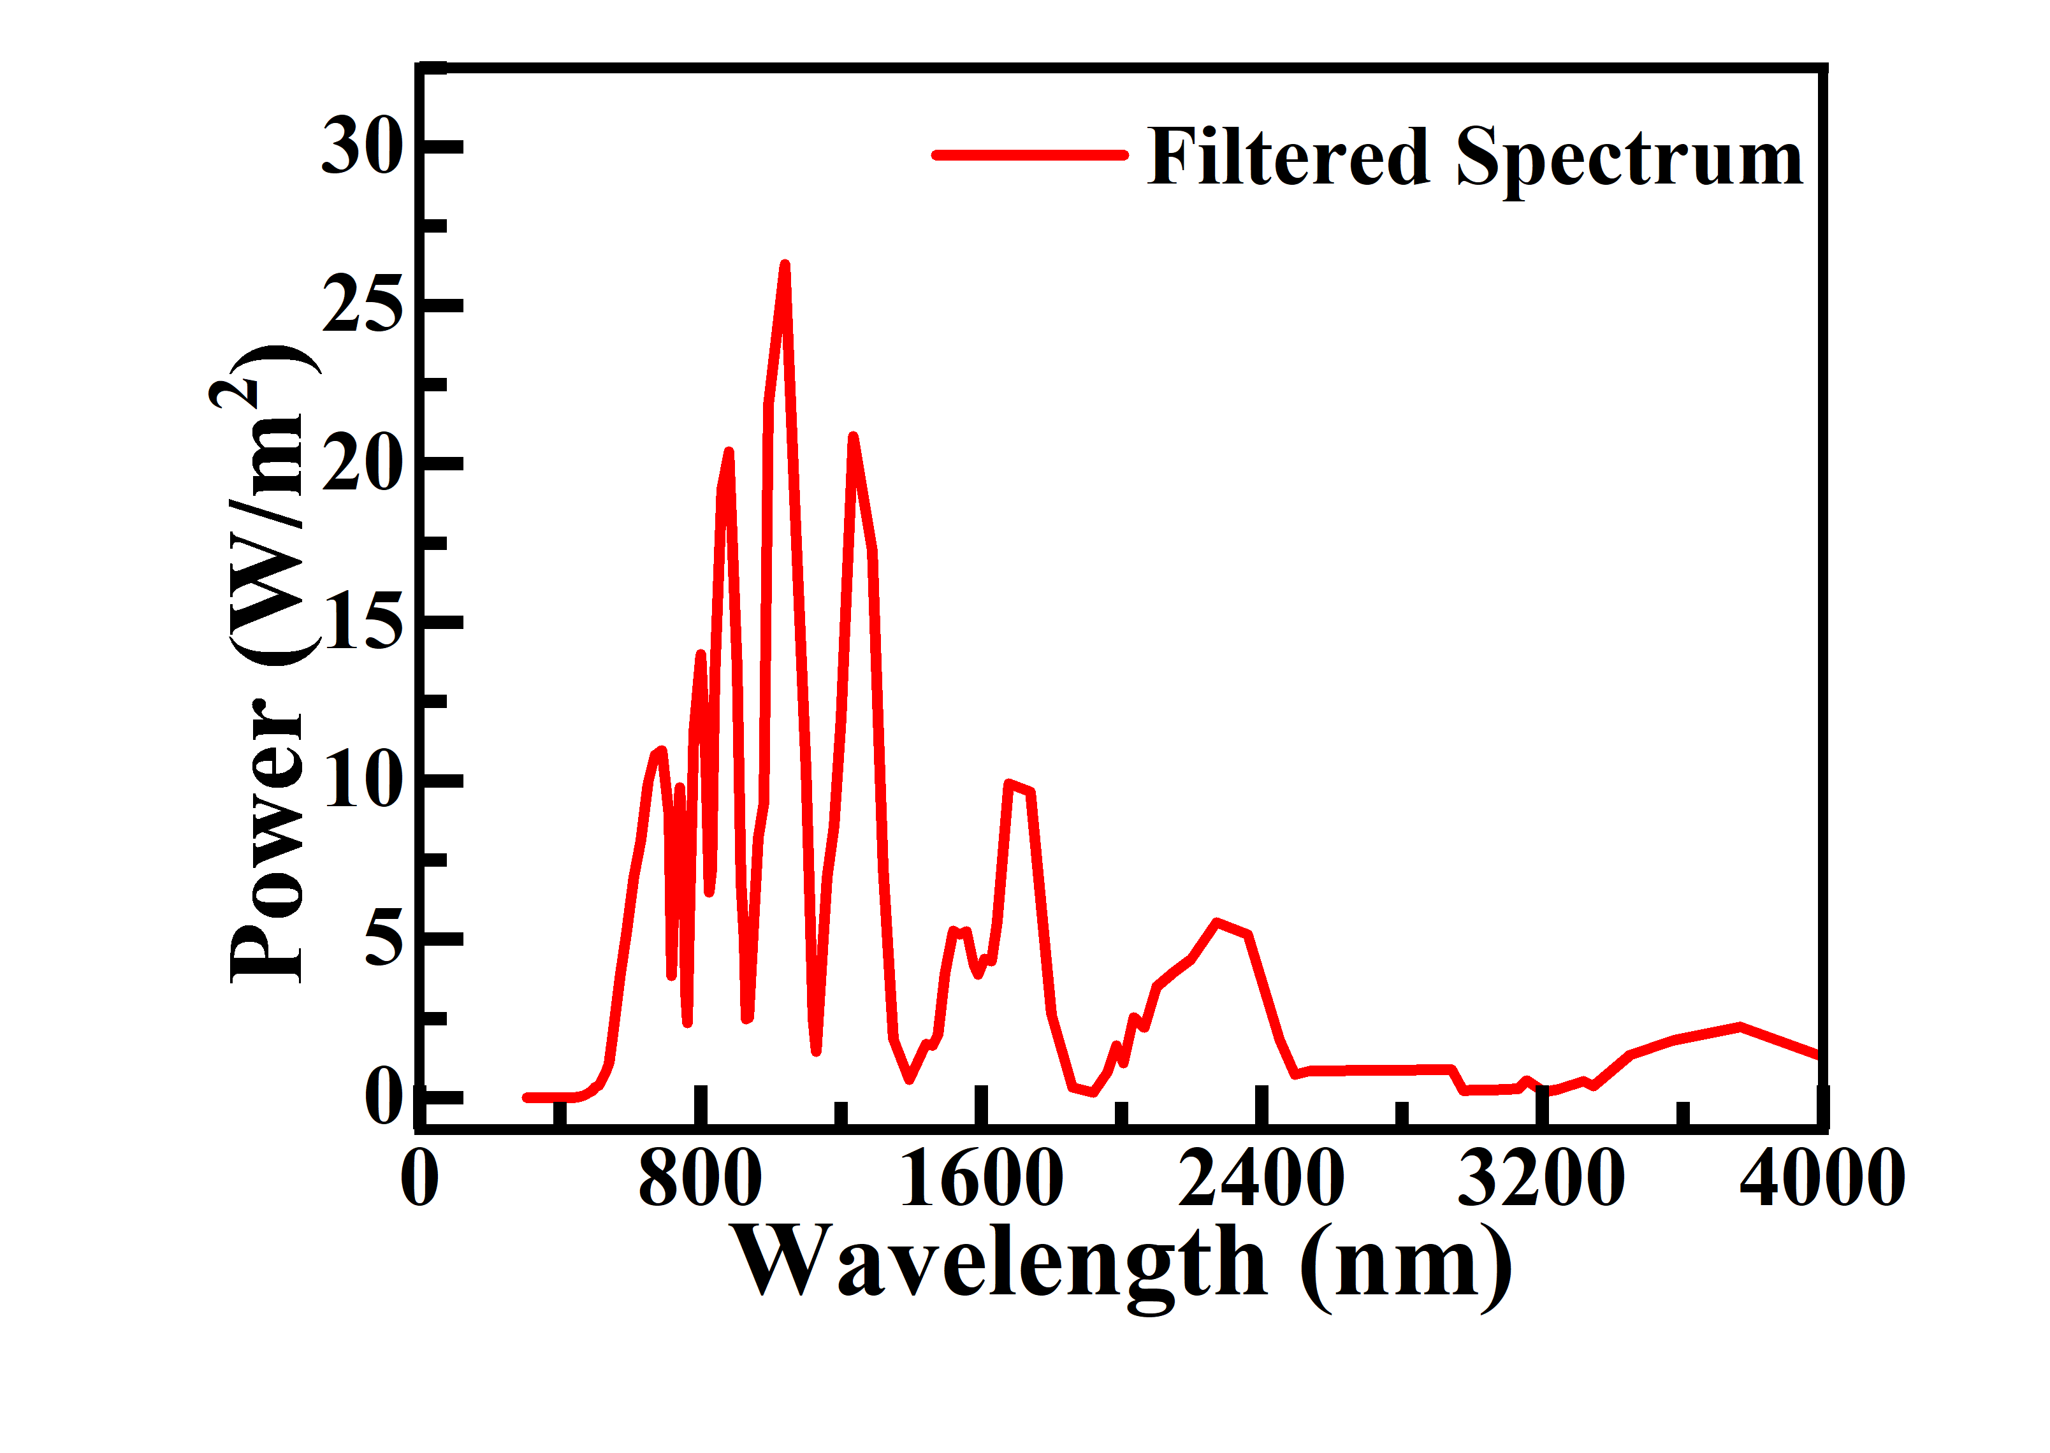
Light
FTO
Top sub-cell
Al
MASnI₃
Cs₃Bi₂I₉
Filtered Light
Load
Recombination Layer
ZnO:Al
i-ZnO
Bottom sub-cell
CdS
CZTSSe
Au

Slide 10
Light
Al
FTO
Cs₂TiBr₆
Top sub-cell
MASnI₃
Cs₃Bi₂I₉
Filtered Light
Load
Recombination Layer
ZnO:Al
i-ZnO
Bottom sub-cell
CdS
CZTSSe
BSF
Au

Slide 11
Light
Al
FTO
Top sub-cell
MASnI₃
Cs₃Bi₂I₉
Load
Filtered Light
Recombination Layer
ZnO:Al
i-ZnO
Bottom sub-cell
CdS
CZTSSe
V₂O₅
Au

Slide 12
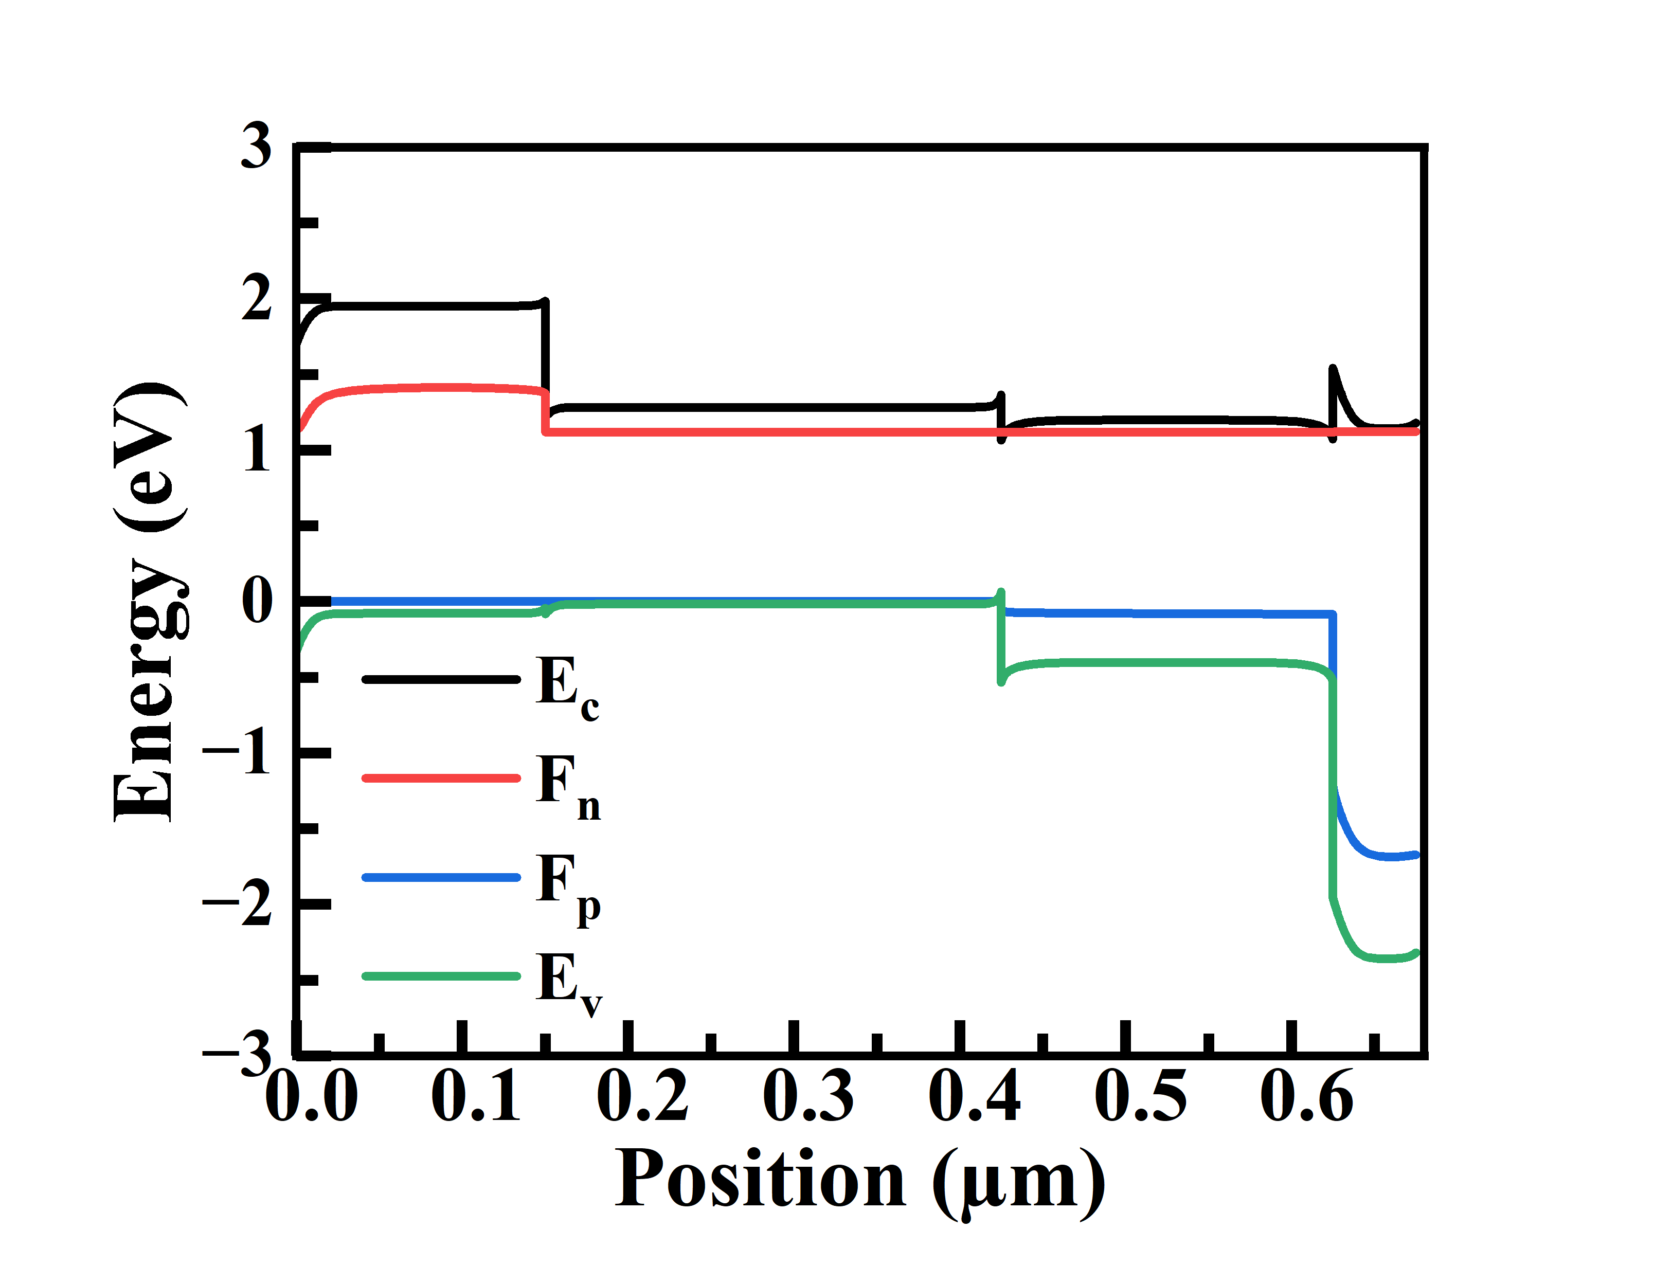
Cs₃Bi₂I₉
Tripple top
MASnI₃
Cs₂TiBr₆
FTO

Slide 13
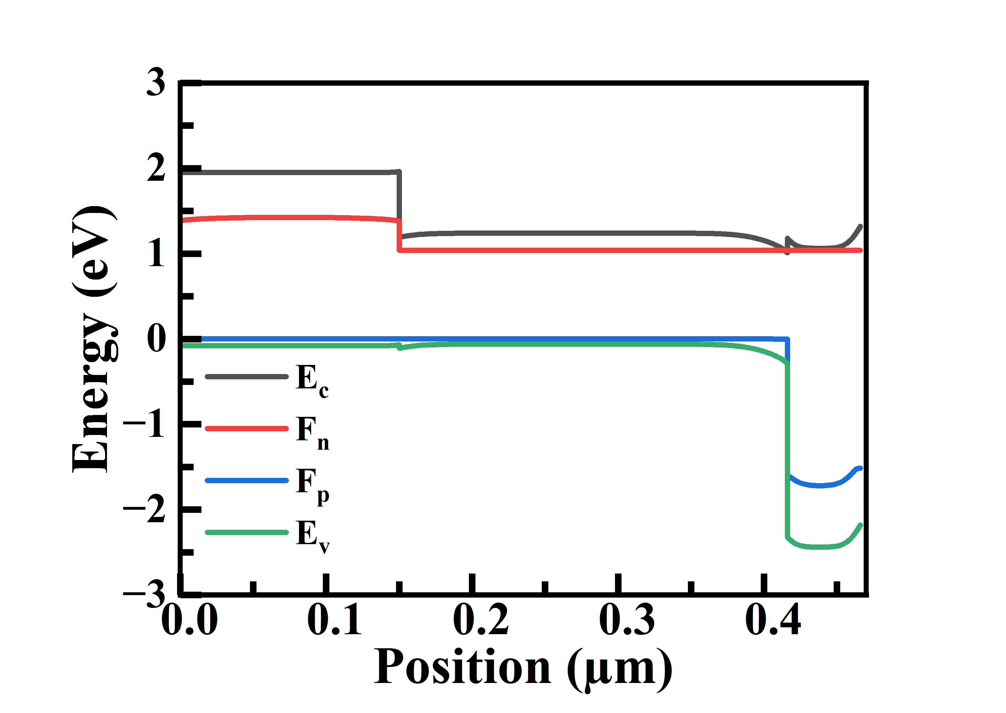
Dual ab
Cs₃Bi₂I₉
MASnI₃
FTO

Slide 14
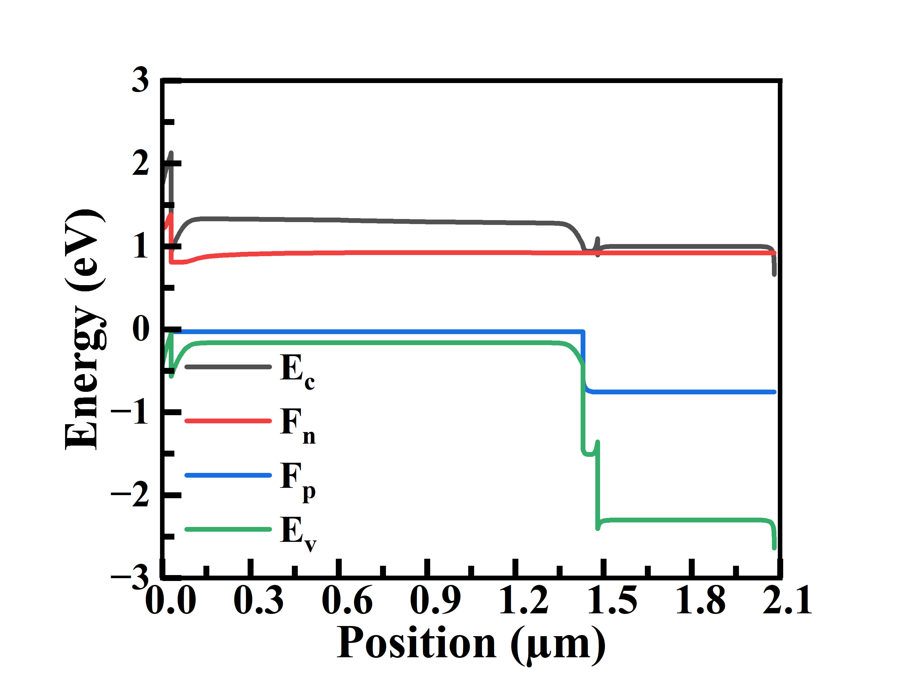
Cu₂O
Cu2O 3 ab
CdS
CZTSSe
Graded (linear): x = 1.00 → 0.90
i-ZnO + ZnO:Al

Slide 15
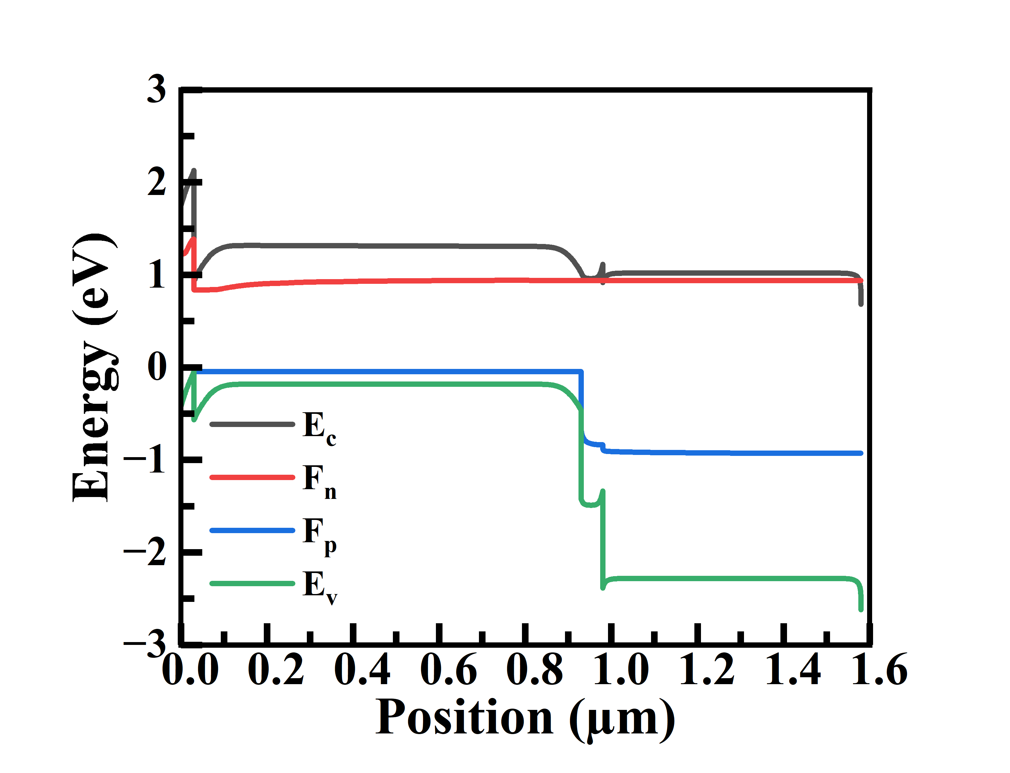
Cu2O 2 ab
Cu₂O
CZTSSe
CdS
Graded (linear): x = 1.00 → 0.973
i-ZnO + ZnO:Al

Slide 16
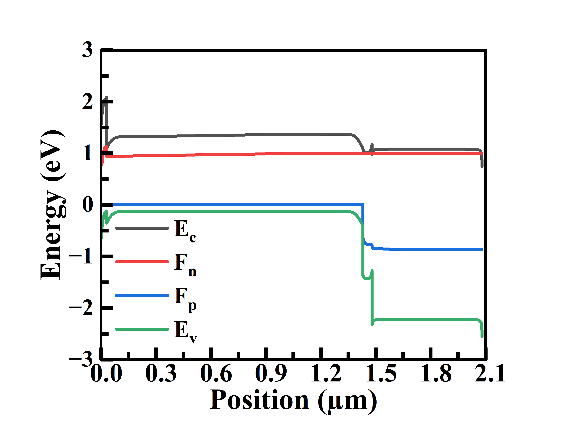
V₂O₅
V2O5 dual
CdS
CZTSSe
Graded (linear): x = 0.914 → 1
i-ZnO + ZnO:Al

Slide 17
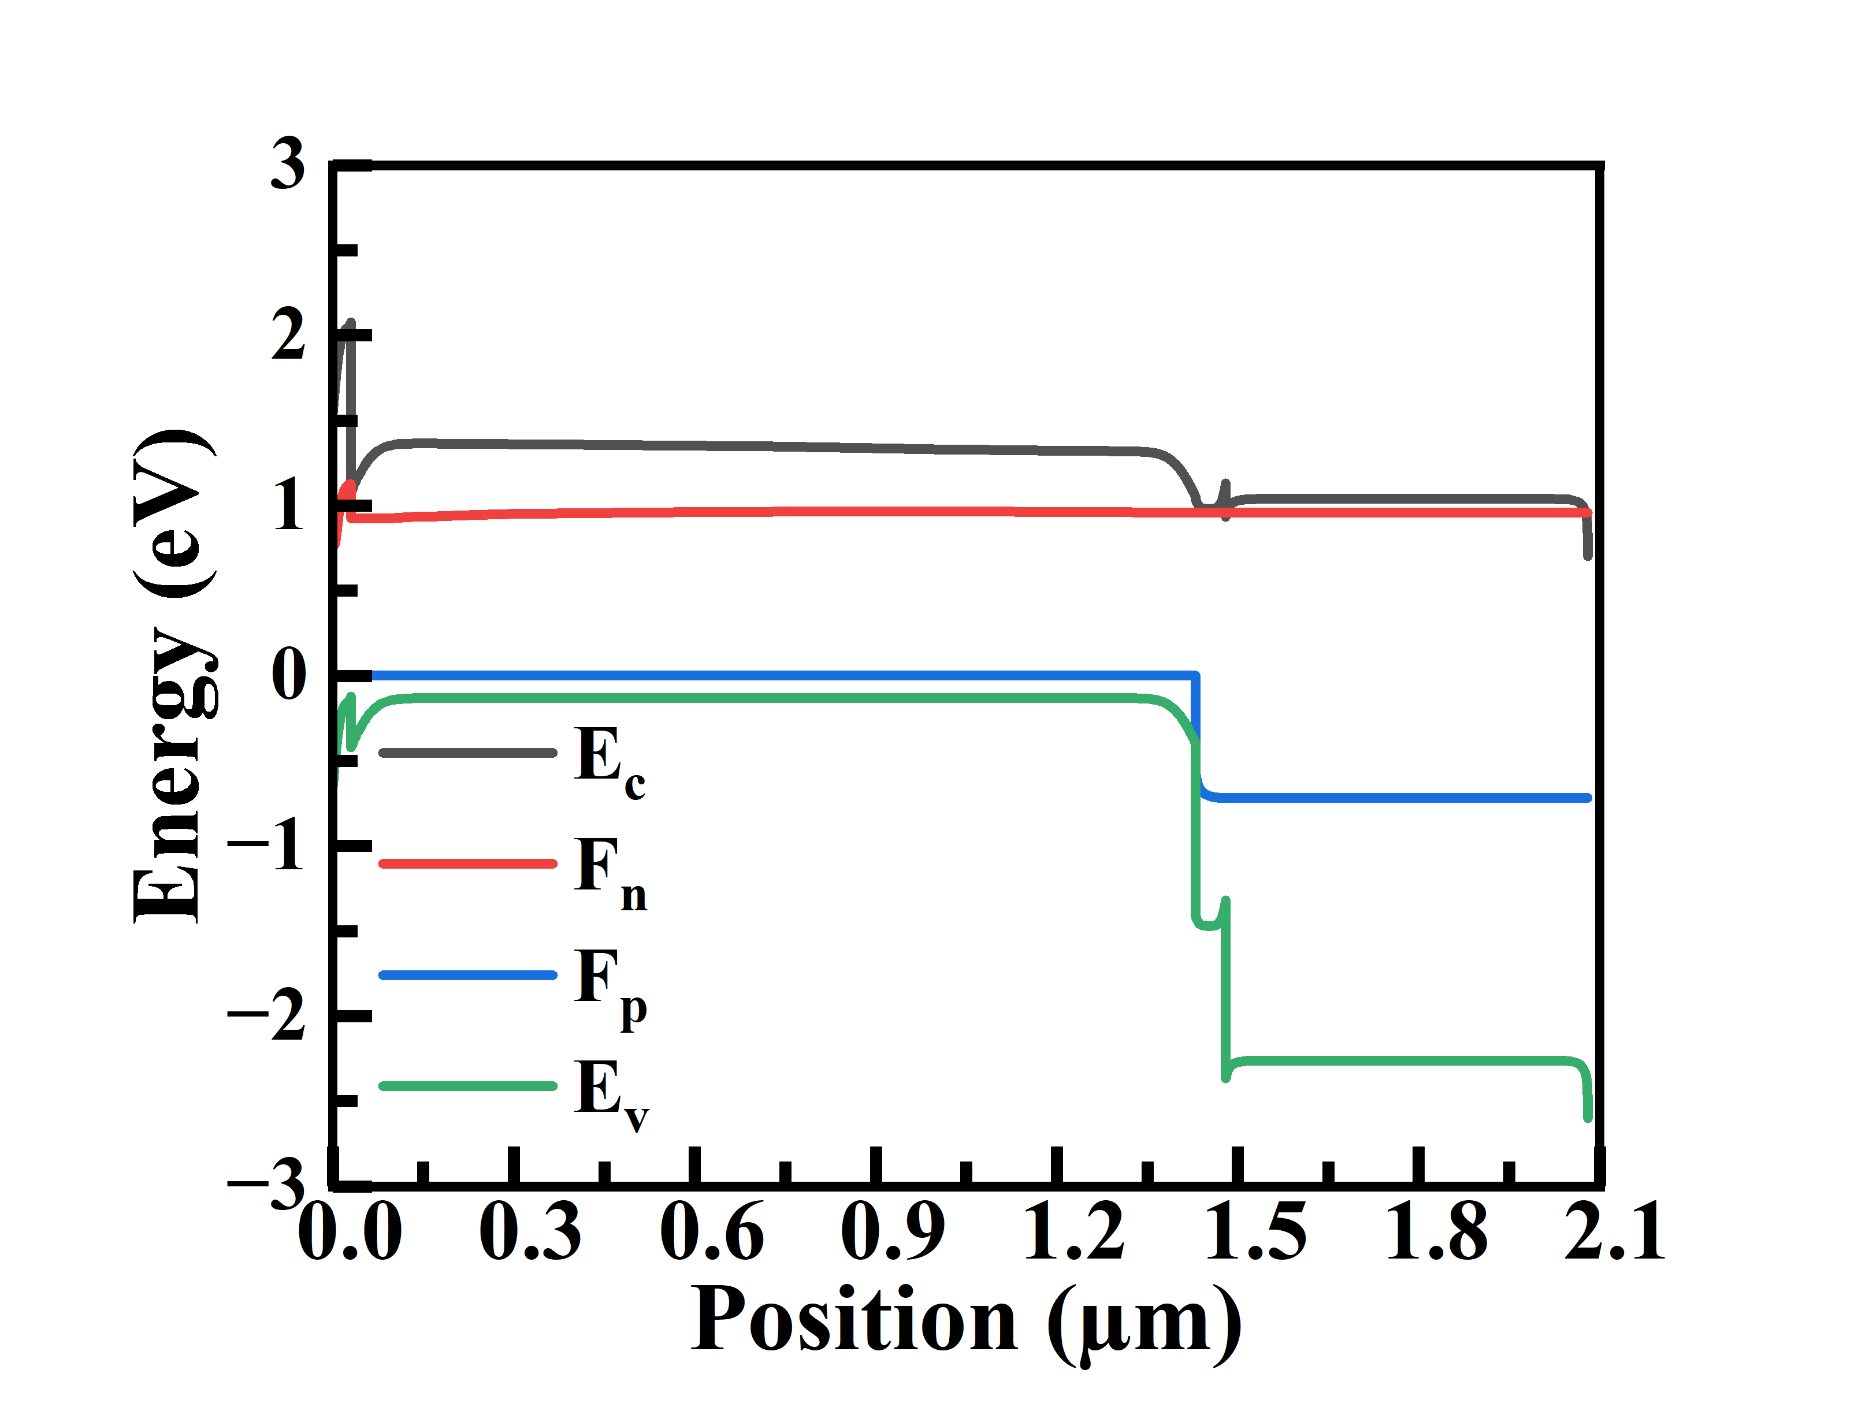
V2O5 triple
V₂O₅
CdS
CZTSSe
Graded (linear): x = 1.00 → 0.914
i-ZnO + ZnO:Al

Slide 18
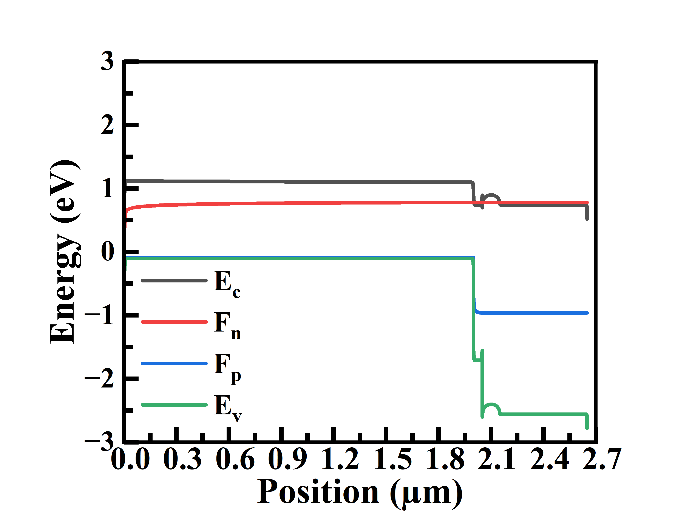
With out T bsf
CZTSSe
CdS
ZnO:Al
Graded (linear): x = 0.5 → 0.537
i-ZnO

Slide 19
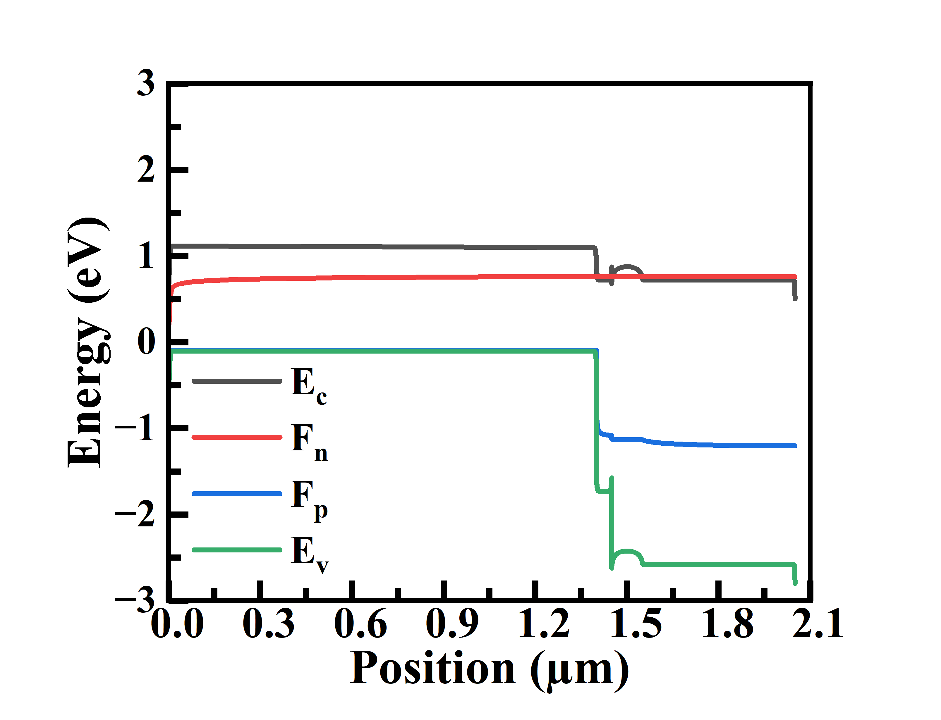
With out D bsf
CZTSSe
CdS
ZnO:Al
Graded (linear): x = 0.5 → 0.537
i-ZnO

Slide 20
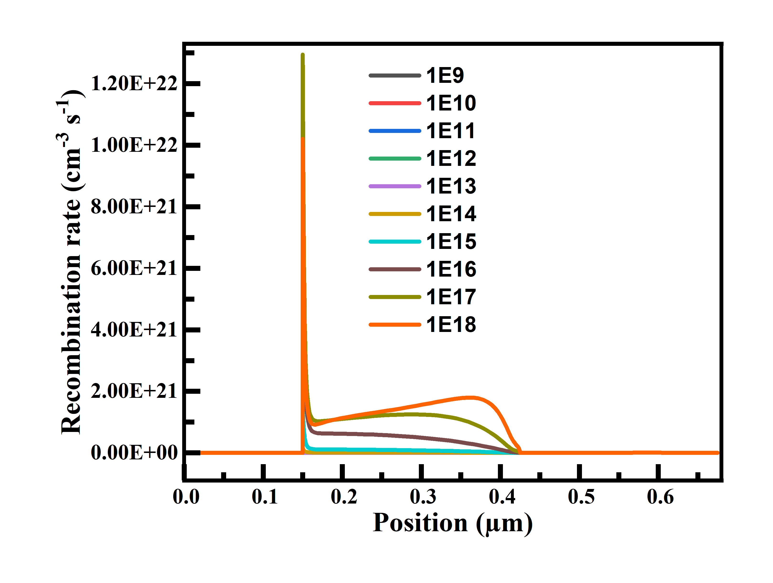
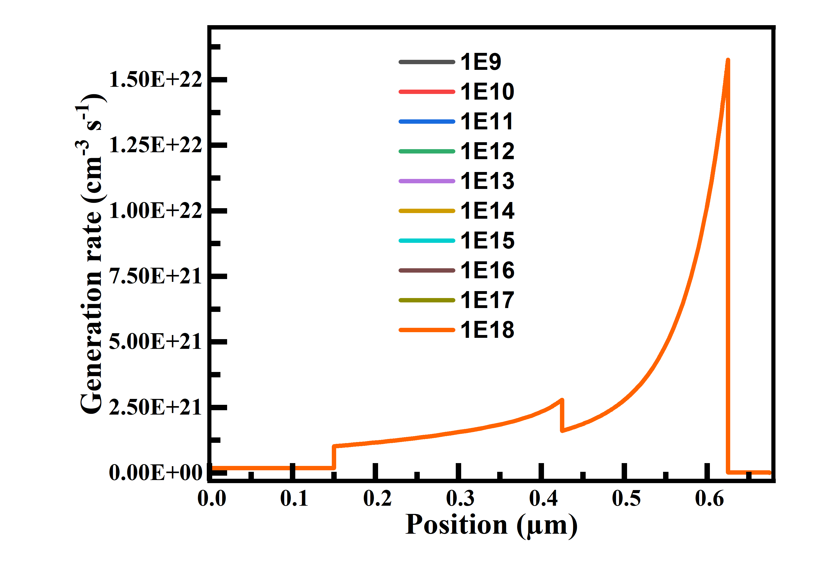

Slide 21
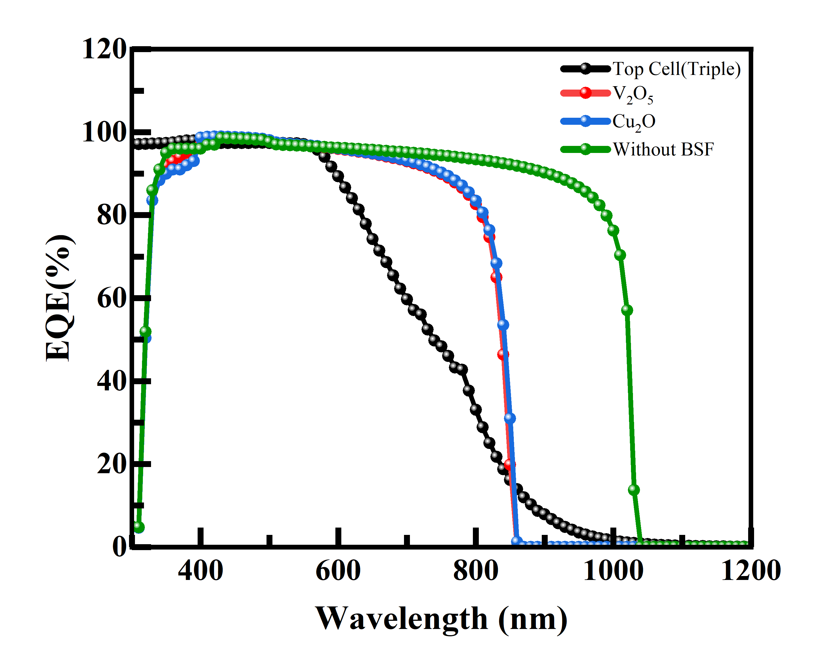

Slide 22
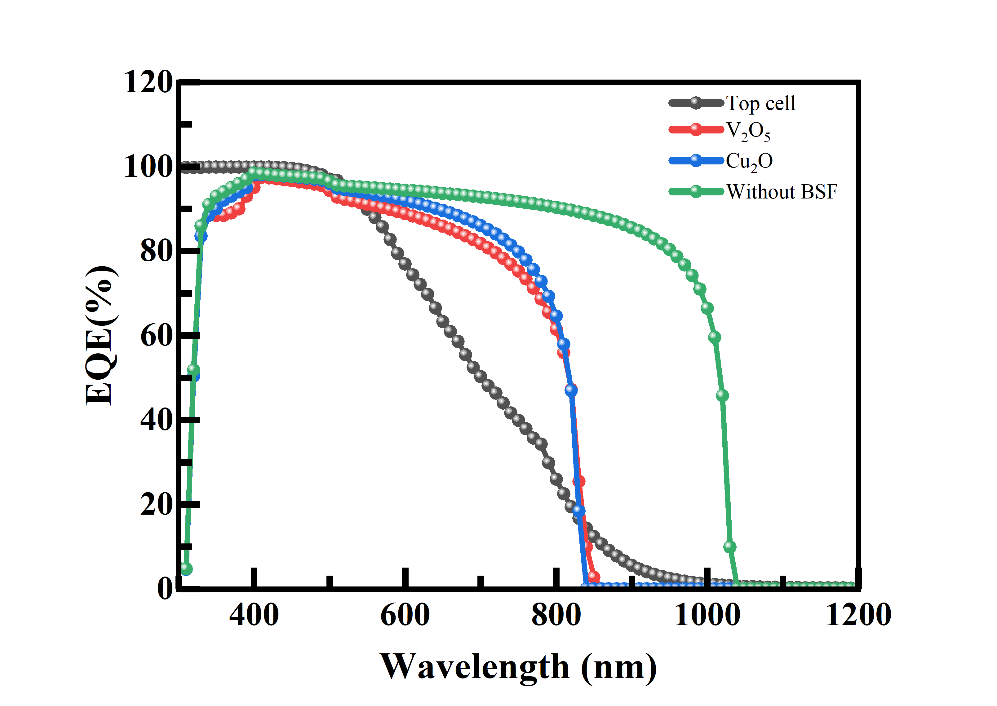
(Dual)

Slide 23
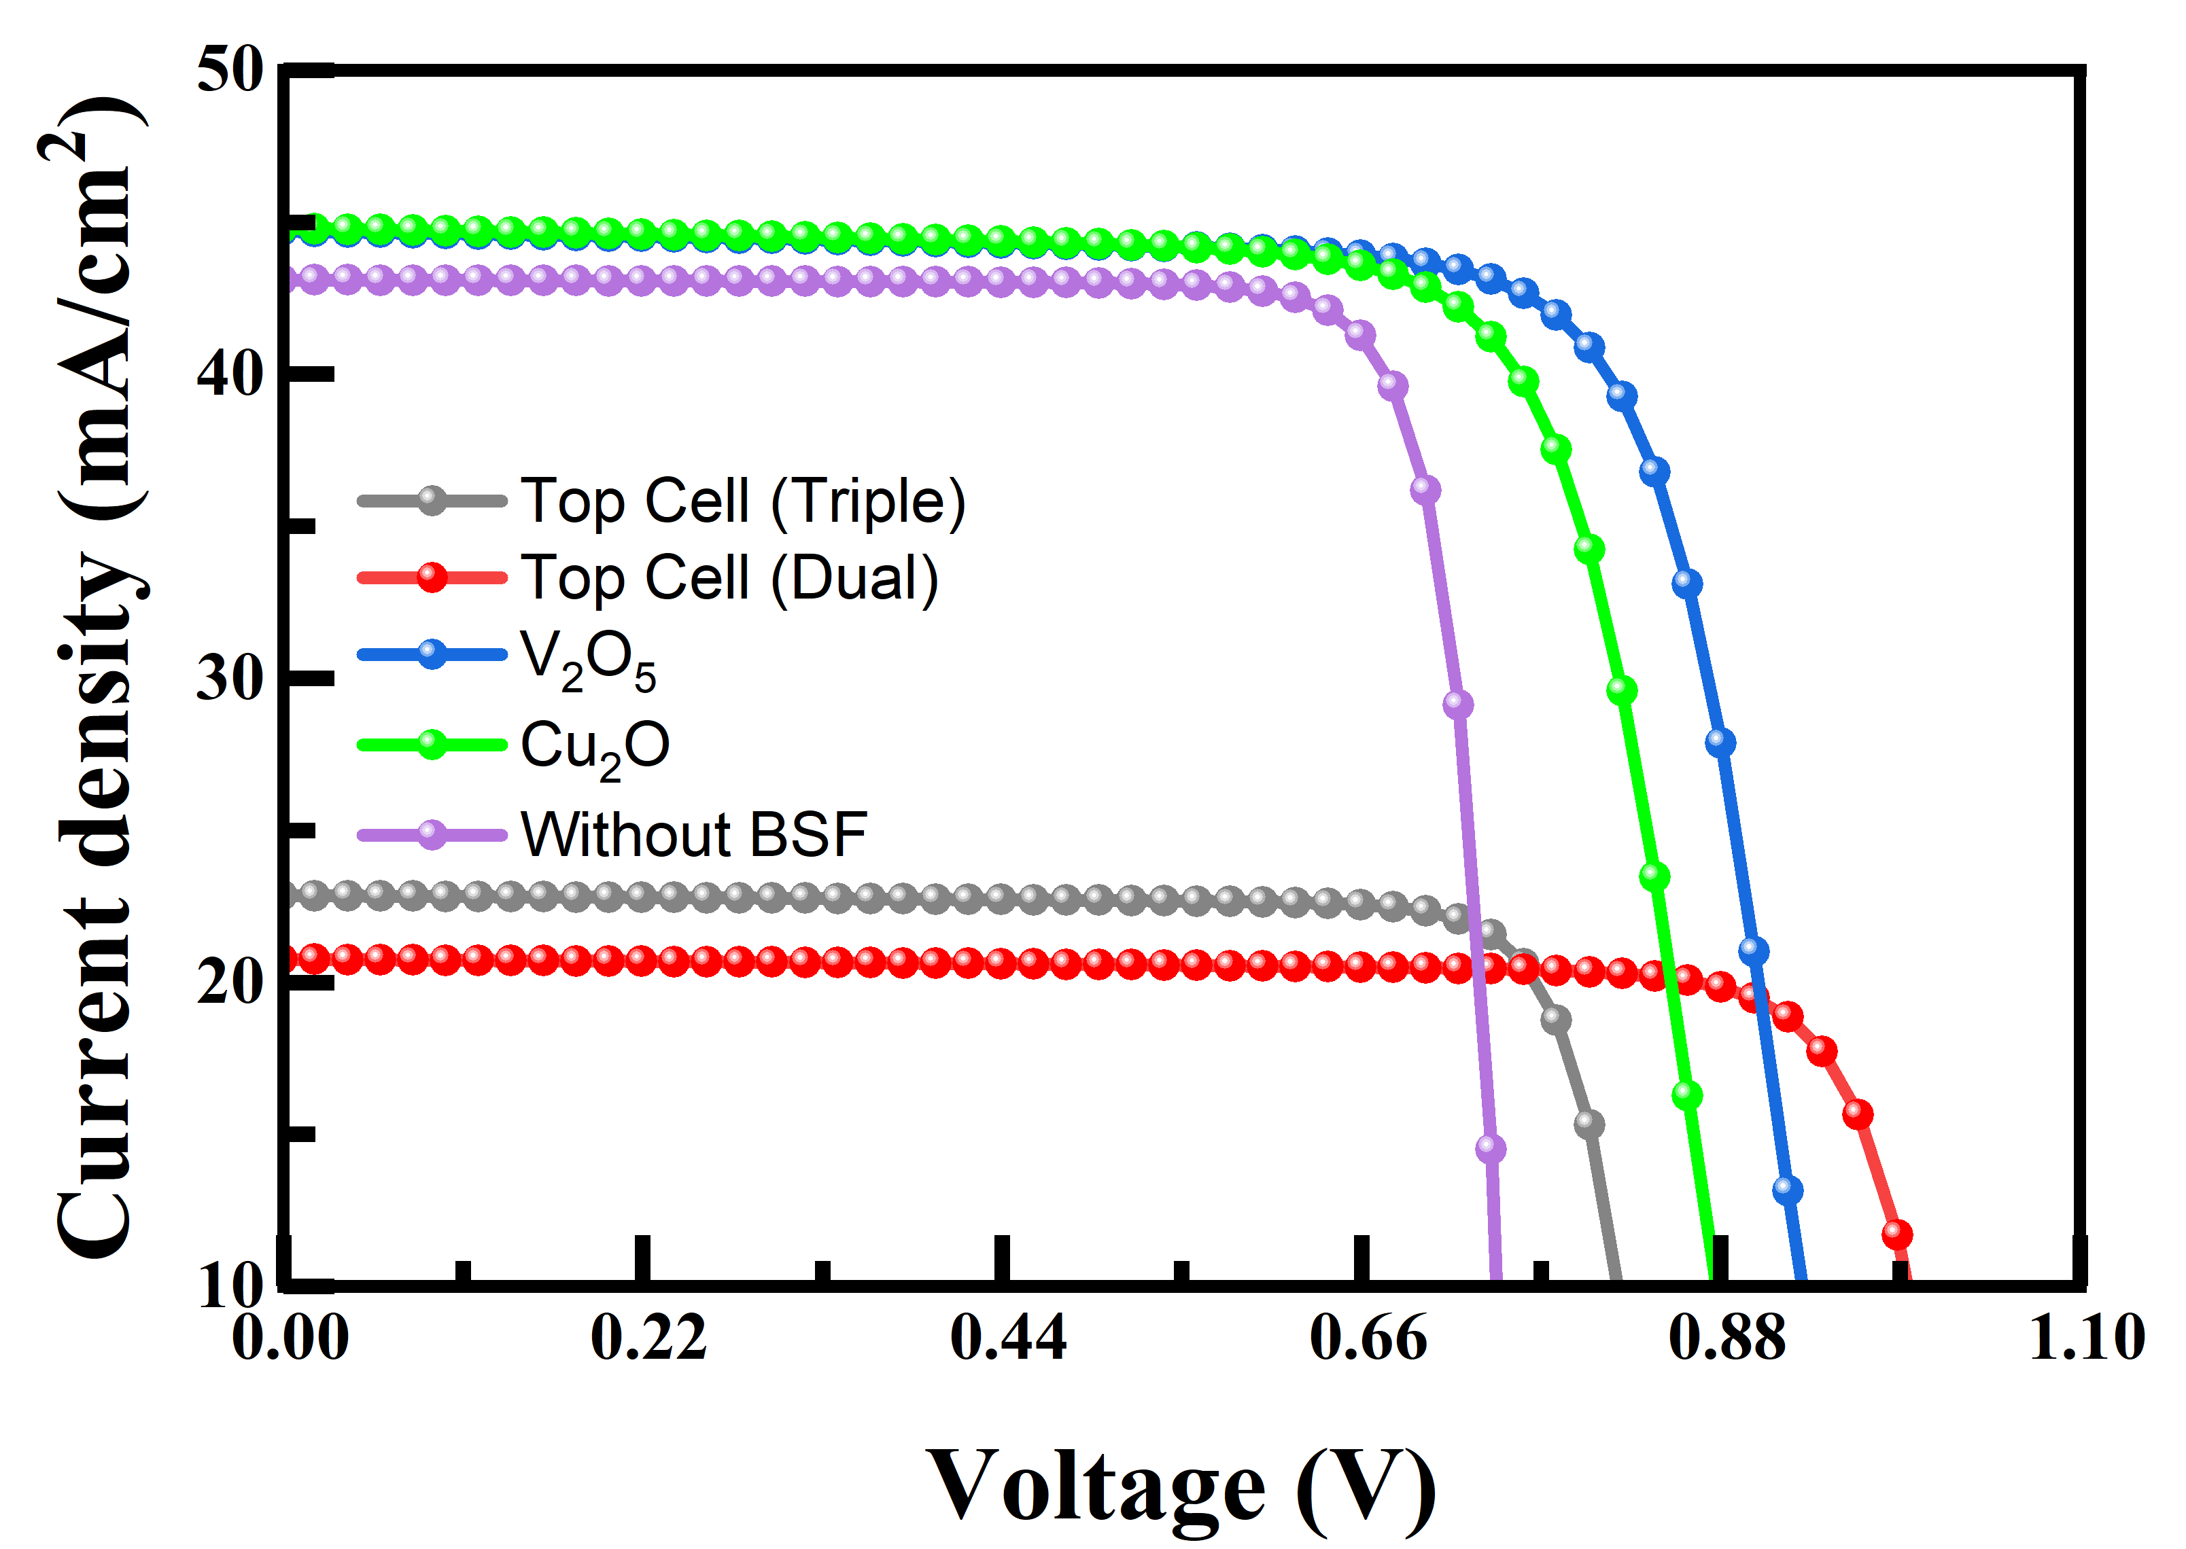

Slide 24
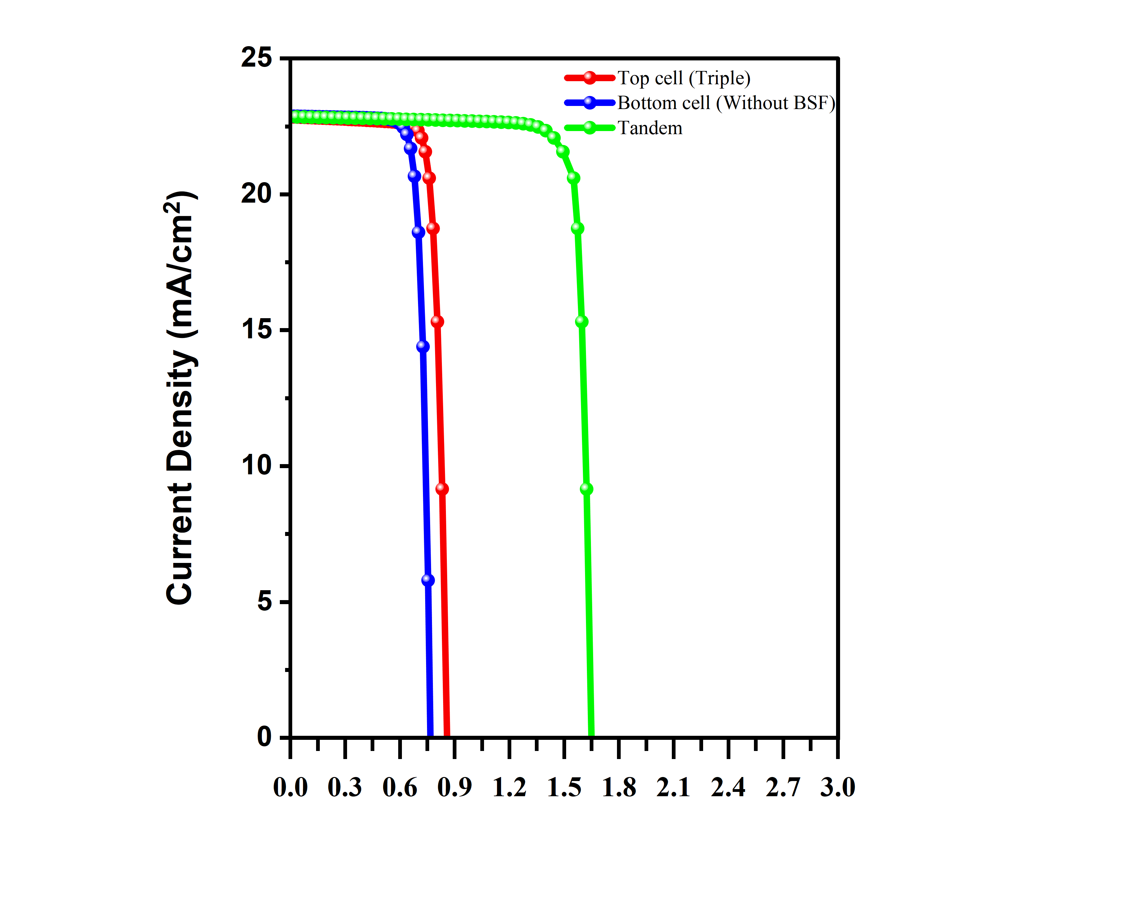
Voltage (V)

Slide 25
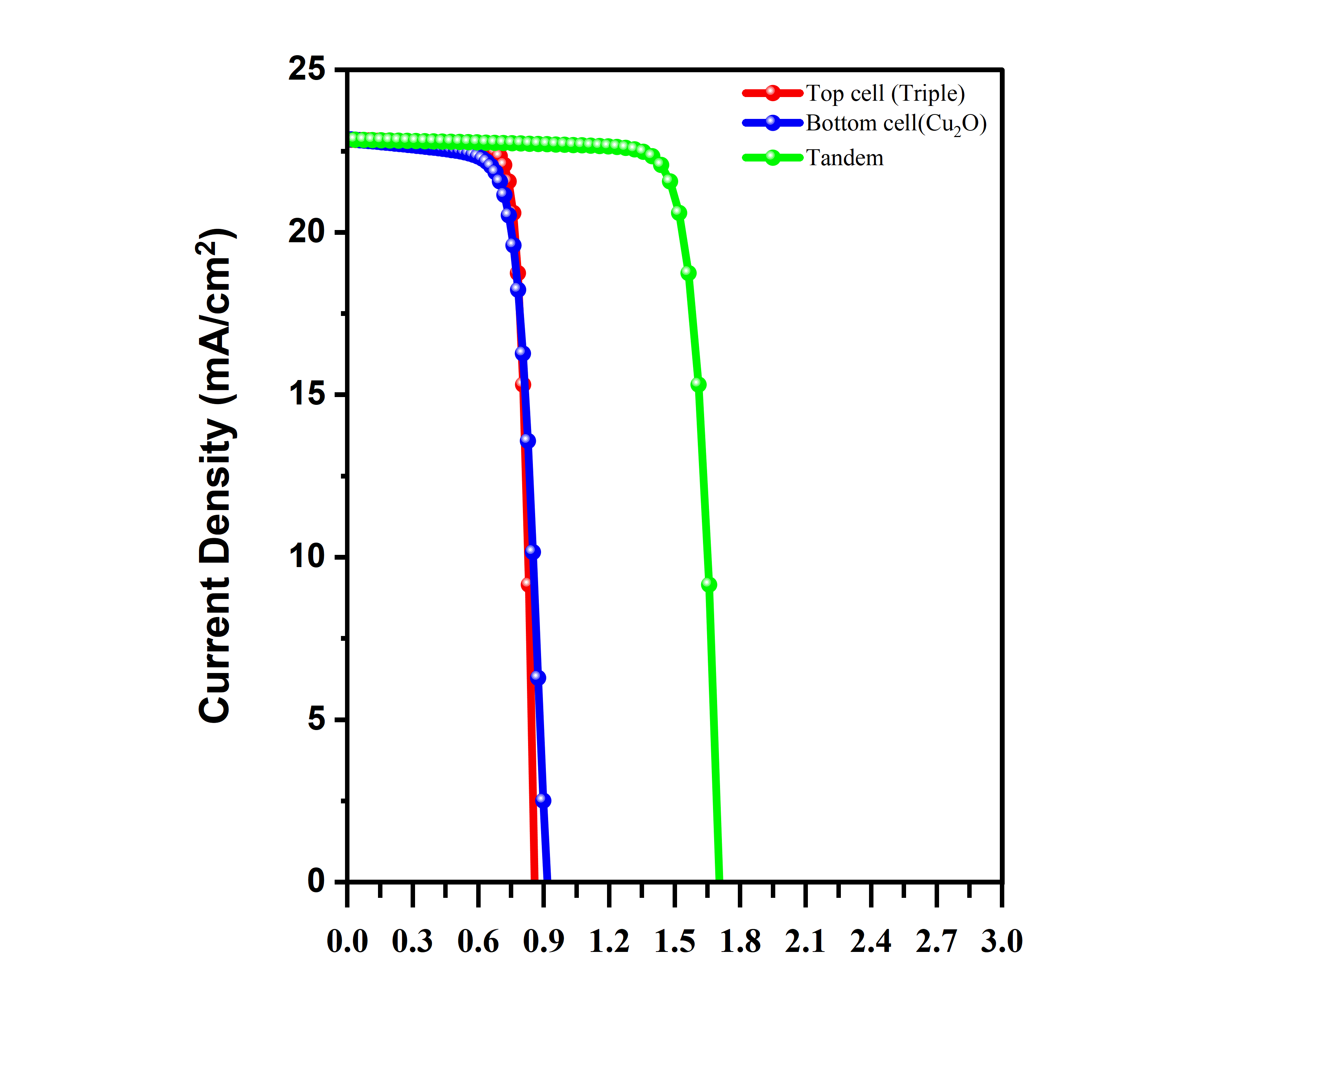
Voltage (V)

Slide 26
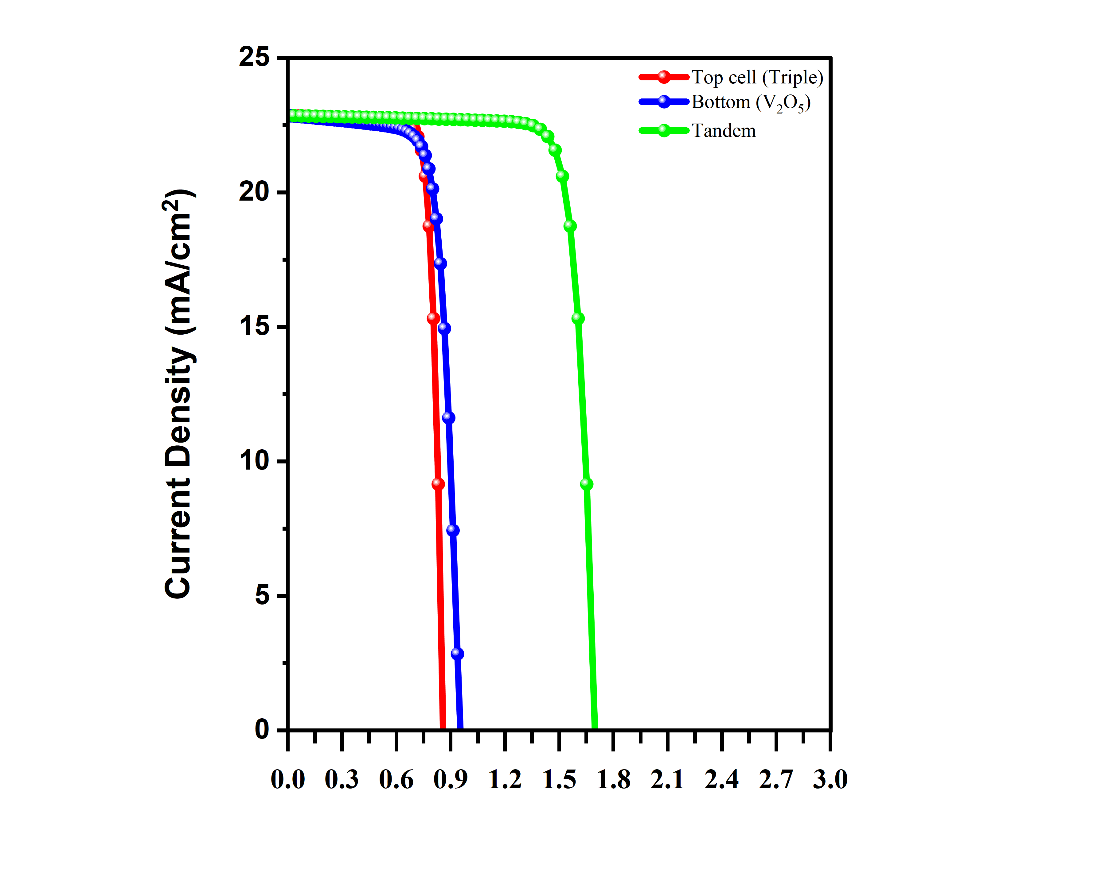
Voltage (V)

Slide 27
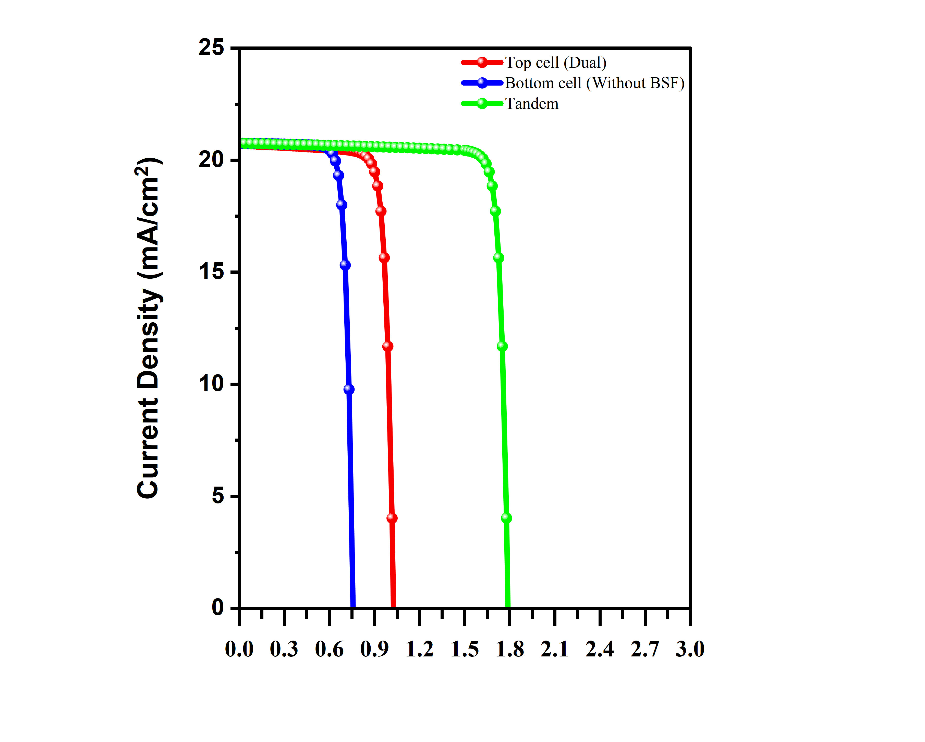
Voltage (V)
Voltage (V)

Slide 28
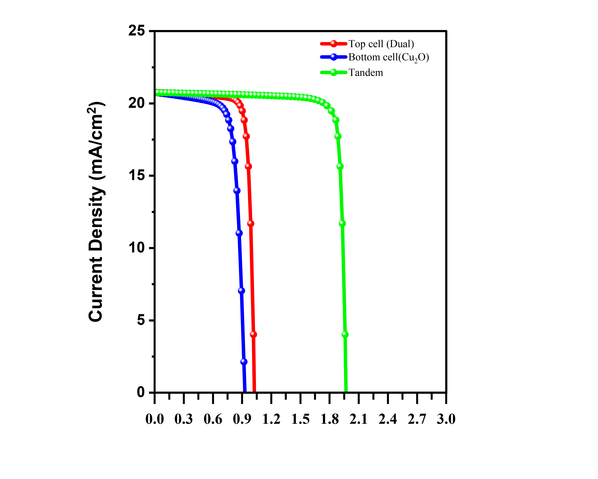
Voltage (V)

Slide 29
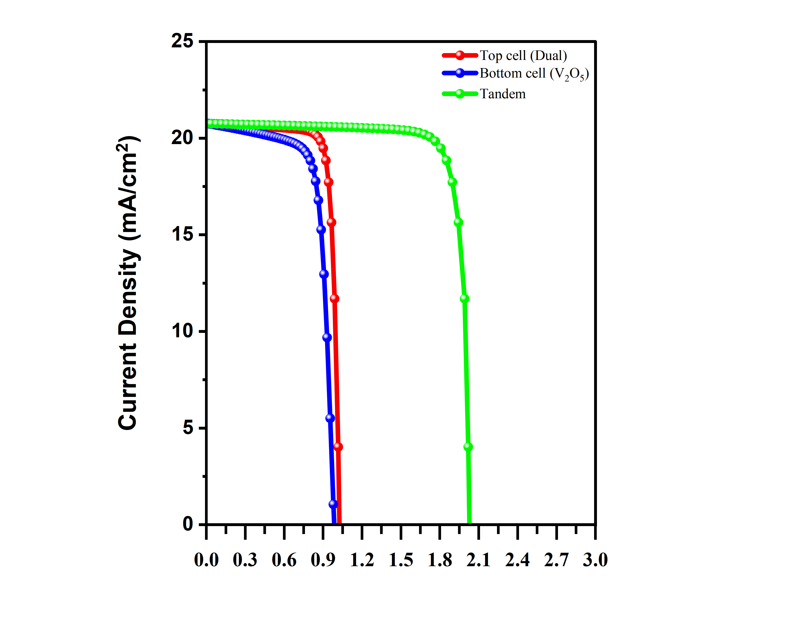
Voltage (V)

Slide 30
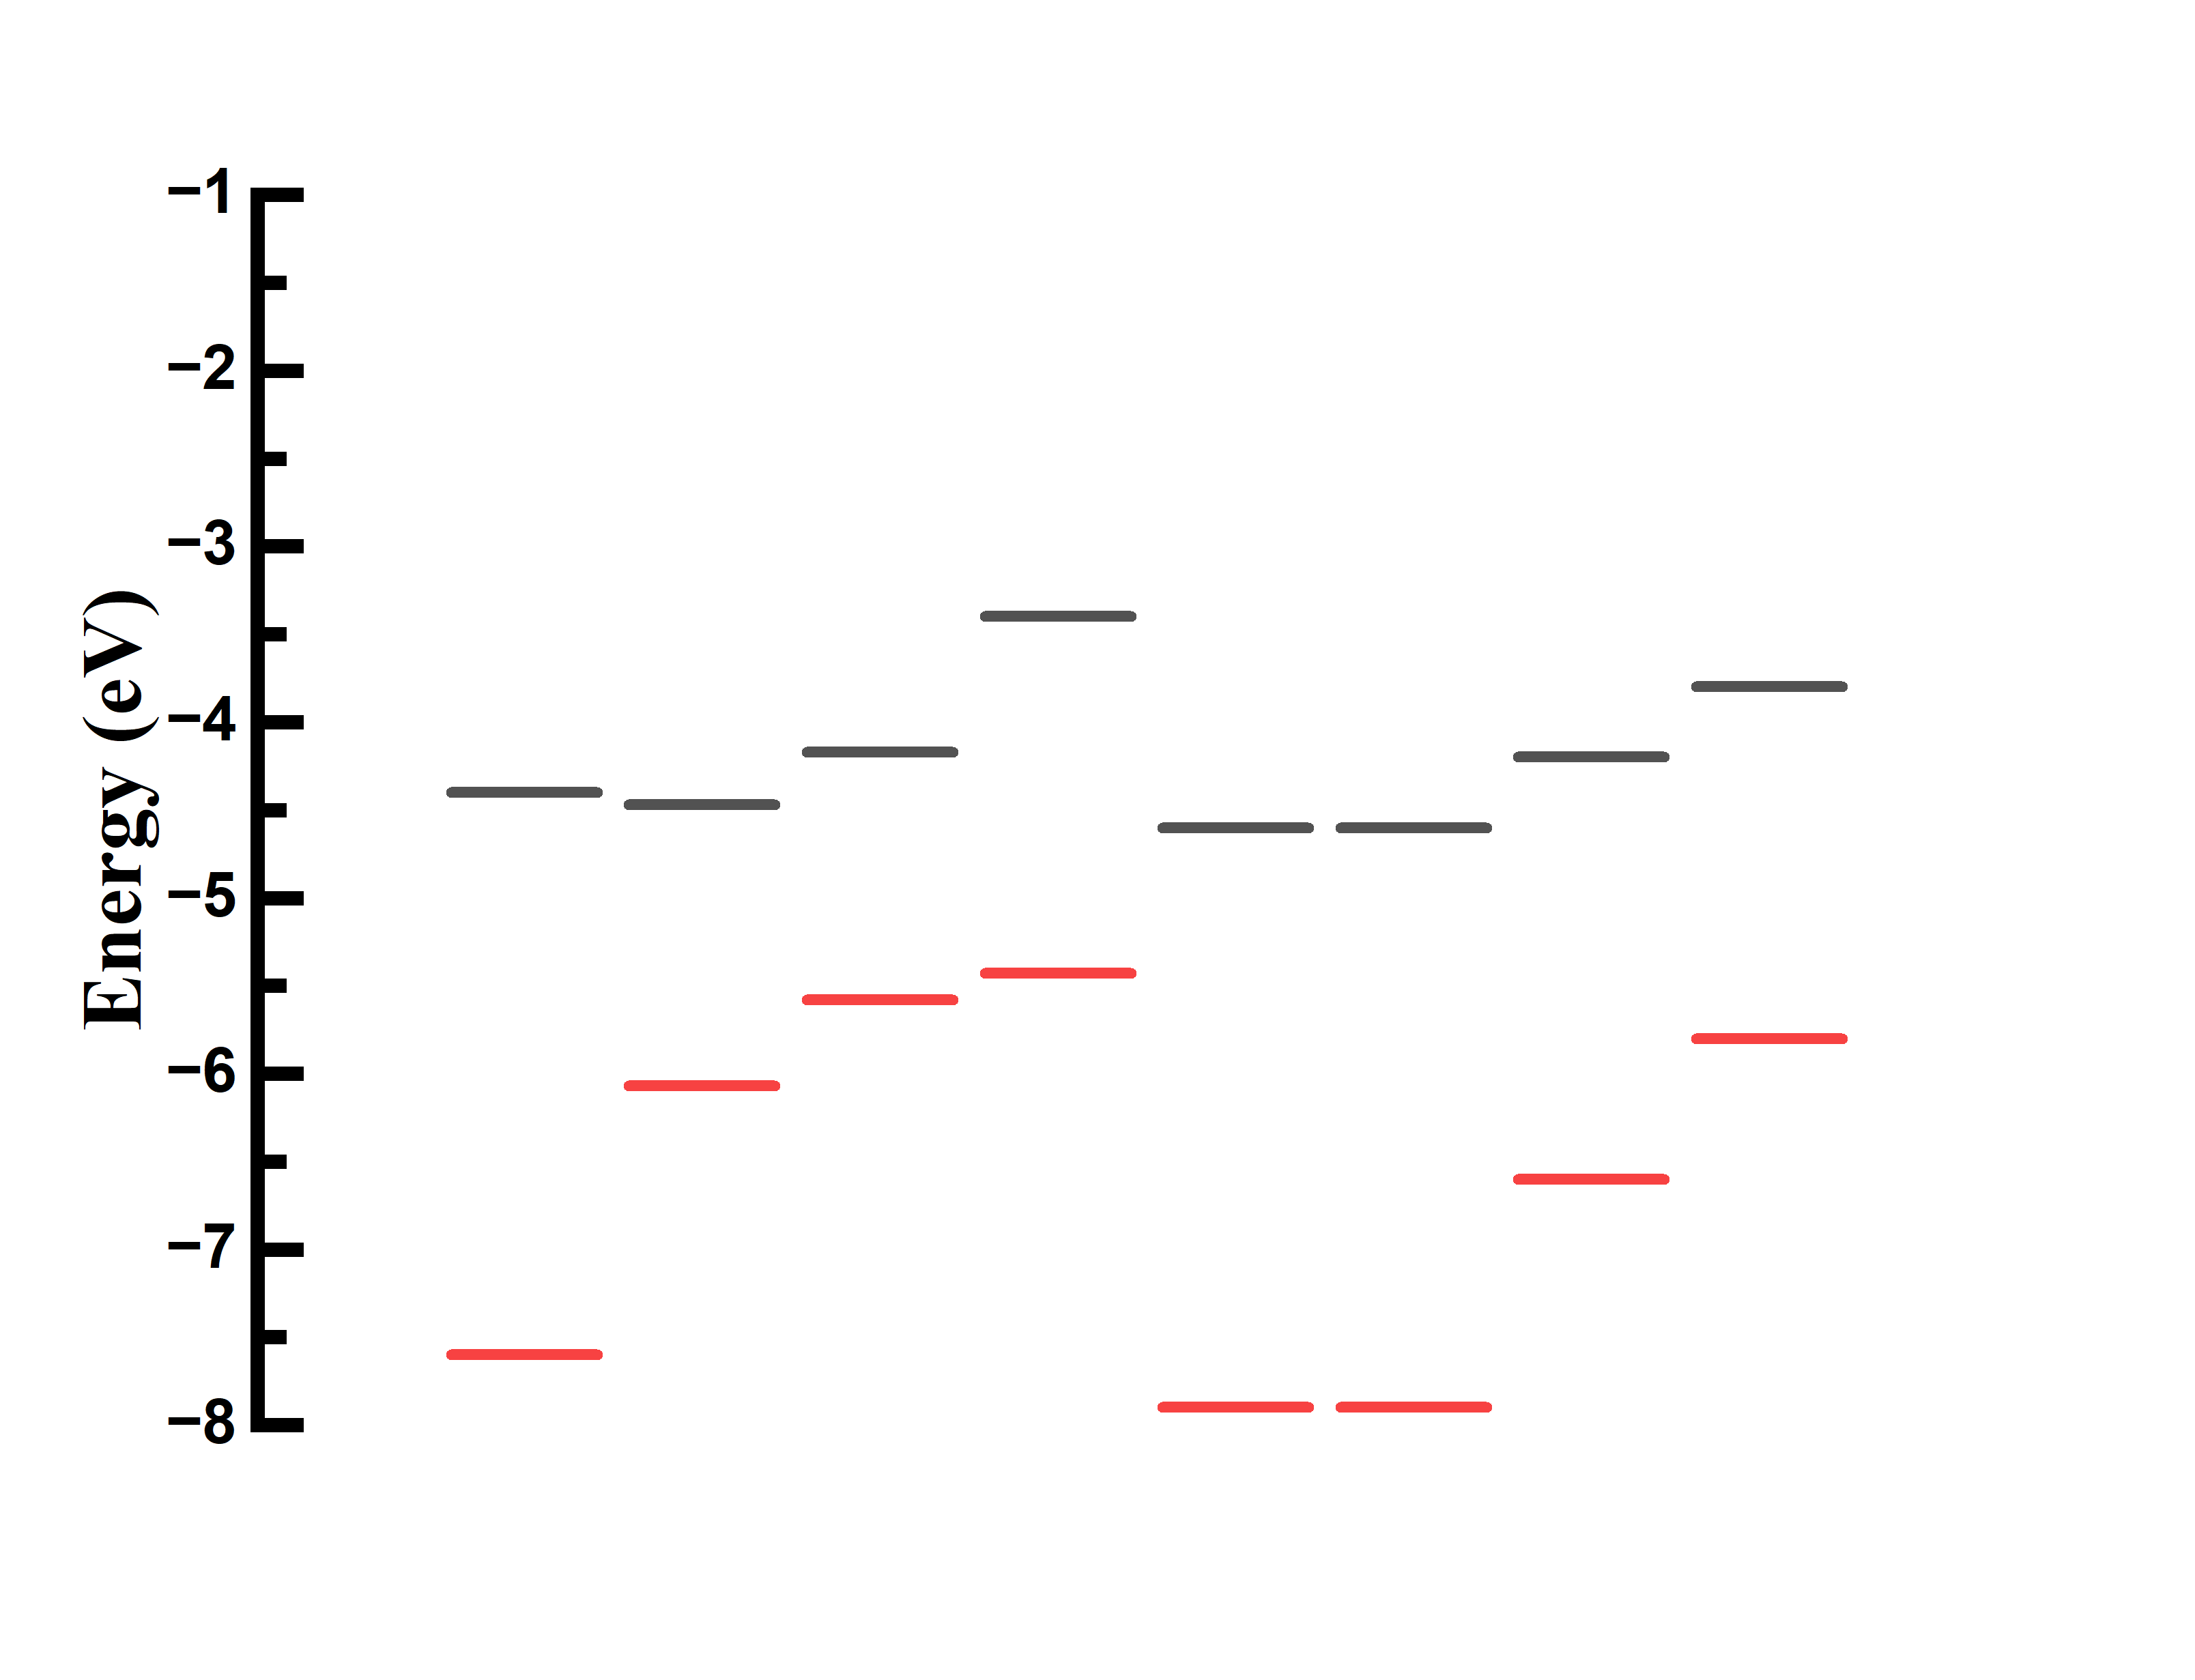
Cs₃Bi₂I₉
MASnI₃
CZTSSe
CdS
Cs₂TiBr₆
i-ZnO
ZnO:Al
-3.4
-3.8
Al
-4.2
-4.2
-4.4
-4.5
-4.6
-4.6
Au
-5.4
-5.6
FTO
-5.2
-6.1
-6.6
-7.6
-7.9
-7.9

Slide 31
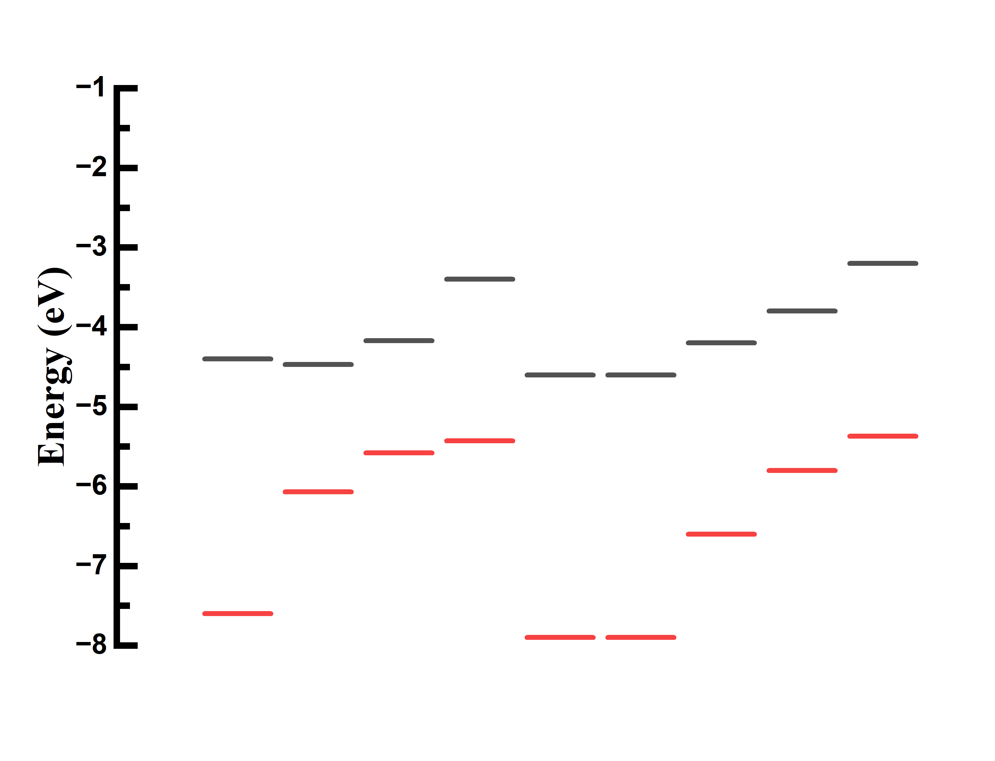
Cu₂O
Cs₃Bi₂I₉
MASnI₃
CZTSSe
CdS
Cs₂TiBr₆
i-ZnO
ZnO:Al
-3.2
-3.4
-3.8
Al
-4.2
-4.4
-4.2
-4.5
-4.6
-4.6
-4.6
Au
-5.4
-5.37
-5.6
FTO
-5.2
-6.1
-6.6
-7.6
-7.9
-7.9

Slide 32
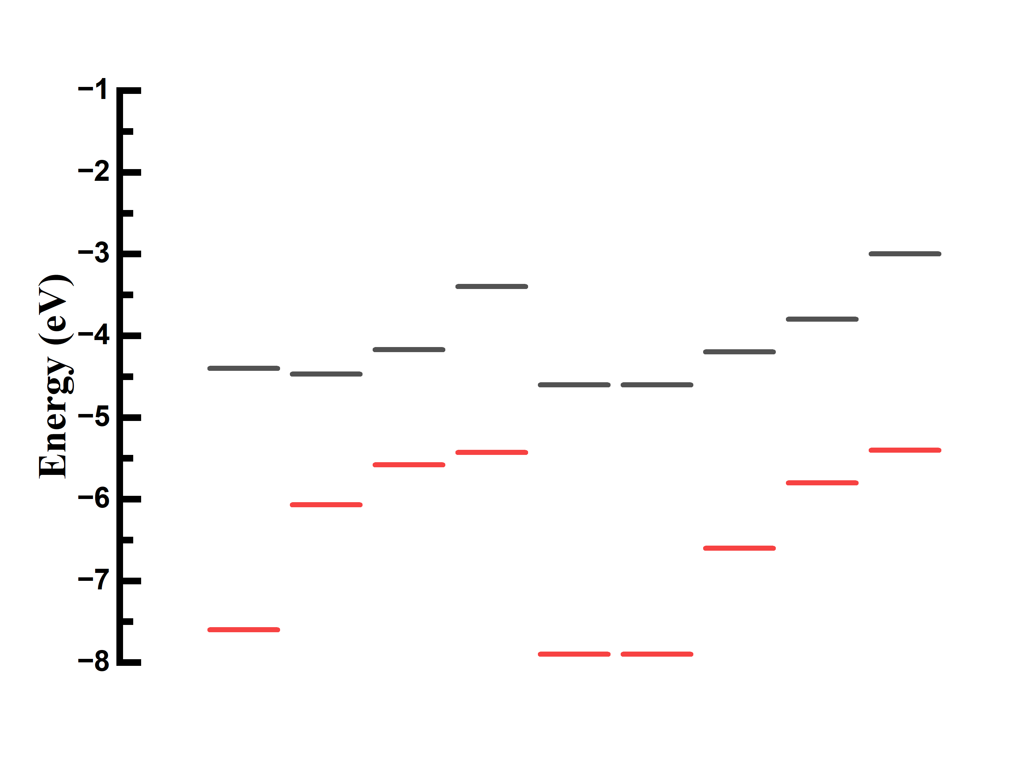
V₂O₅
Cs₃Bi₂I₉
Cs₃Bi₂I₉
MASnI₃
MASnI₃
CZTSSe
CdS
CdS
Cs₂TiBr₆
i-ZnO
i-ZnO
ZnO:Al
ZnO:Al
-3
-3.4
-3.4
-3.8
Al
Al
-4.2
-4.4
-4.2
-4.5
-4.6
-4.6
Au
-5.4
-5.4
-5.6
FTO
-5.2
FTO
-6.1
-6.1
-6.6
-7.6
-7.6
-7.9
-7.9

Slide 33
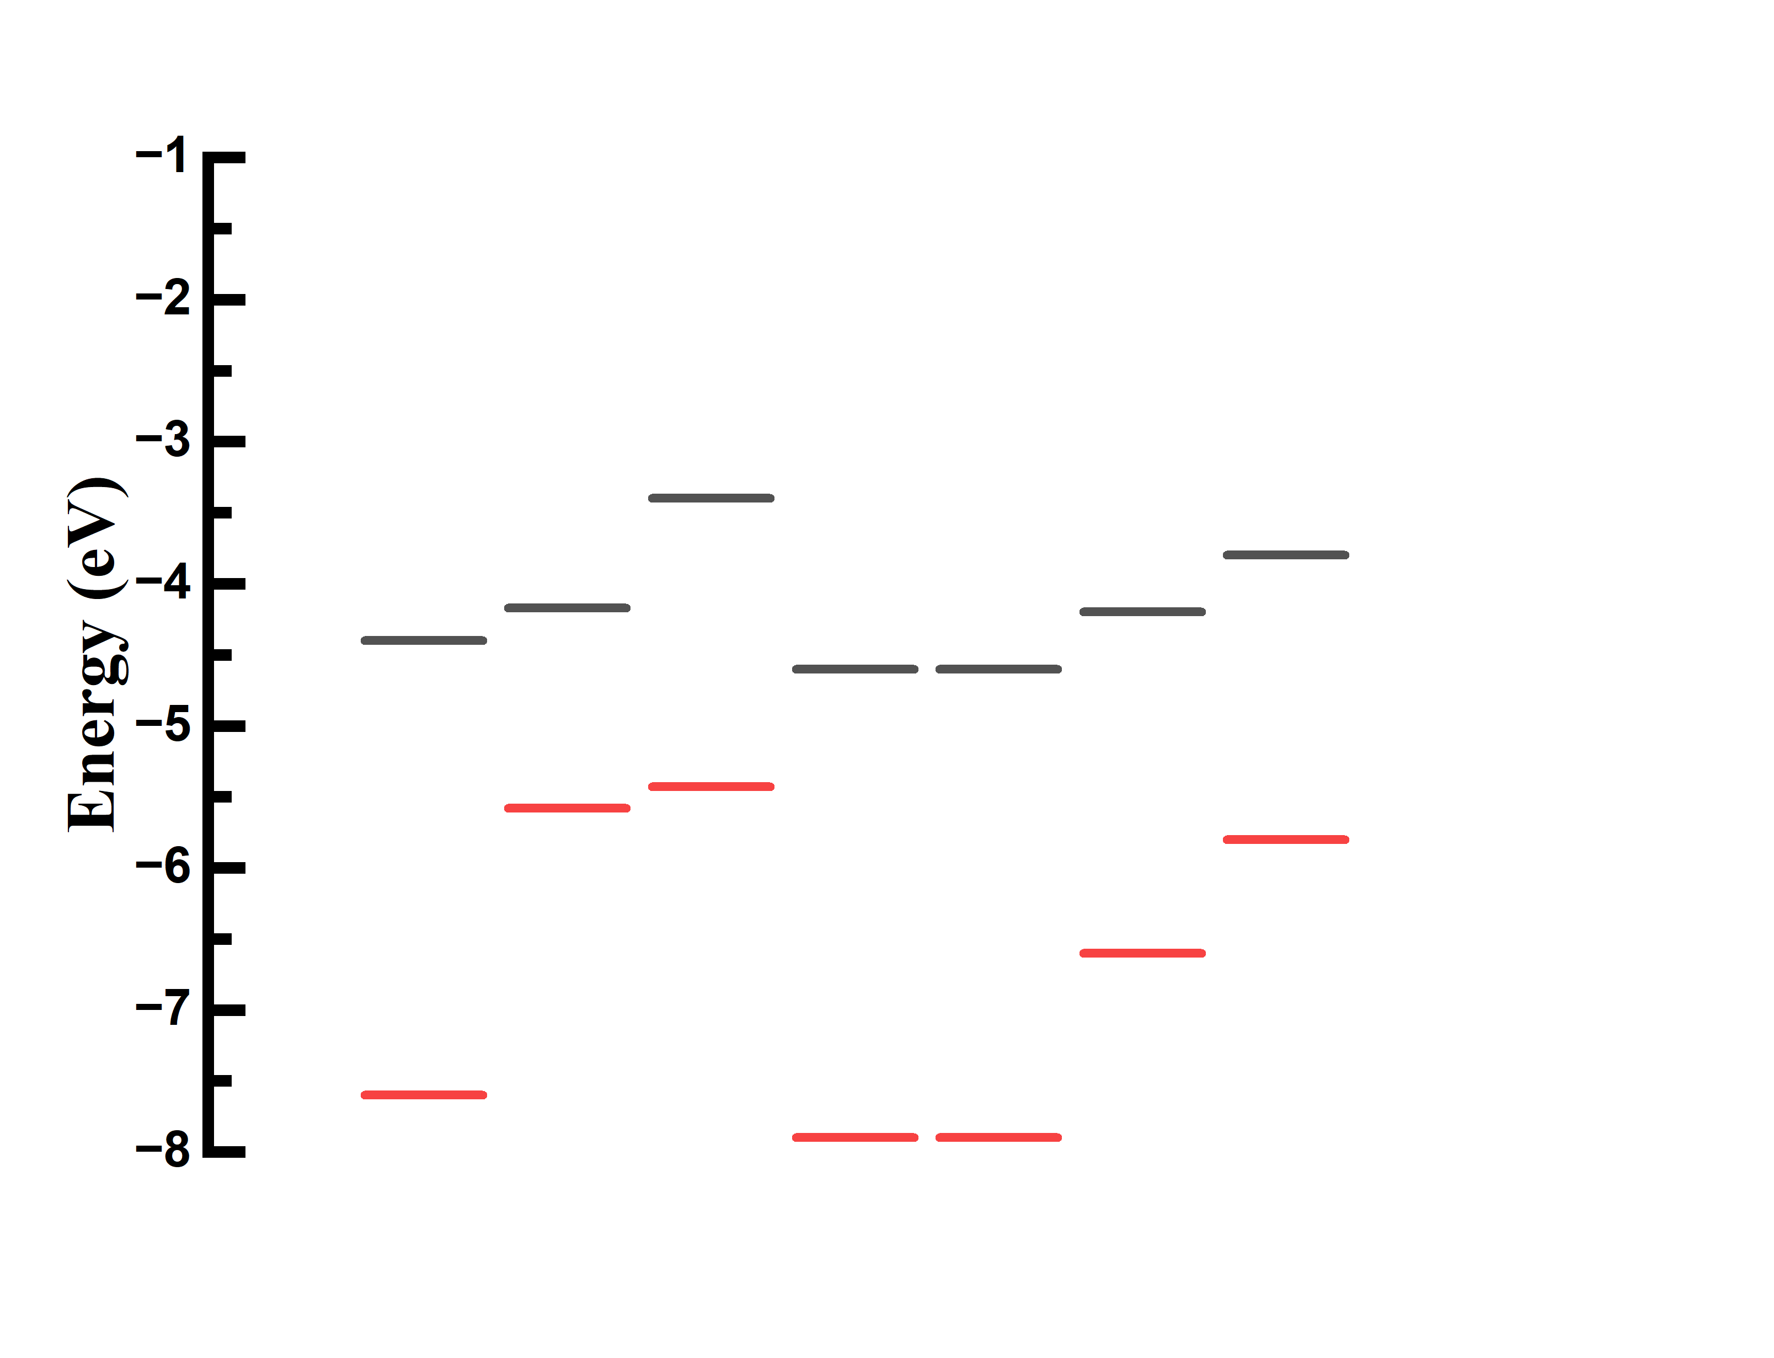
Cs₃Bi₂I₉
MASnI₃
CZTSSe
CdS
i-ZnO
ZnO:Al
-3.4
-3.8
-4.2
Al
-4.2
-4.4
-4.6
-4.6
Au
-5.4
-5.6
FTO
-5.2
-6.6
-7.6
-7.9
-7.9

Slide 34
Cu₂O
Cs₃Bi₂I₉
MASnI₃
CZTSSe
CdS
i-ZnO
ZnO:Al
-3.2
-3.4
-3.8
-4.2
Al
-4.2
-4.4
-4.6
-4.6
Au
-5.37
-5.4
-5.6
FTO
-5.2
-6.6
-7.6
-7.9
-7.9

Slide 35
V₂O₅
Cs₃Bi₂I₉
MASnI₃
CZTSSe
CdS
i-ZnO
ZnO:Al
-3
-3.4
-3.8
Al
-4.2
-4.2
-4.4
-4.6
-4.6
Au
-5.4
-5.6
-5.4
FTO
-5.2
-6.6
-7.6
-7.9
-7.9

Slide 46
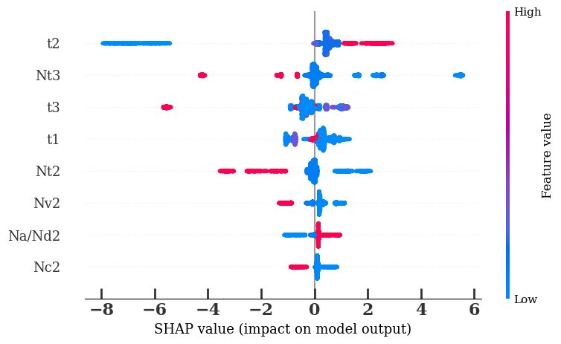
High
Thickness L₂
Defect density L₃
Thickness L₃
Thickness L₁
Feature value
Defect density L₂
Valence band DOS L₂
Acceptor density L₂
Conduction Band DOS L₂
Low
SHAP value (impact on model output)

Slide 47
High
Valence band DOS L₂
Conduction Band DOS L₂
Donor density L₃
Acceptor density L₂
Feature value
Bandgap L₂
Electron affinity L₂
Electron affinity L₃
Defect density L₃
Low
SHAP value (impact on model output)

Slide 48
High
Thickness L₂
Thickness L₃
Defect density L₃
Thickness L₁
Feature value
Defect density L₂
Valence band DOS L₁
Donor density L₃
Acceptor density L₂
Low
SHAP value (impact on model output)

Slide 49
High
Donor density L₃
Valence band DOS L₂
Acceptor density L₂
Conduction band DOS L₃
Feature value
Valence band DOS L₁
Thickness L₂
Dielectric permittivity L₂
Thickness L₃
Low
SHAP value (impact on model output)

Slide 56
V_{OC}
V_{OC}
V_{OC}
V_{OC}

Slide 57
V_{OC}
V_{OC}
V_{OC}
V_{OC}

Slide 58
J_{SC}
J_{SC}
J_{SC}
J_{SC}

Slide 59
J_{SC}
J_{SC}
J_{SC}
J_{SC}

Slide 67
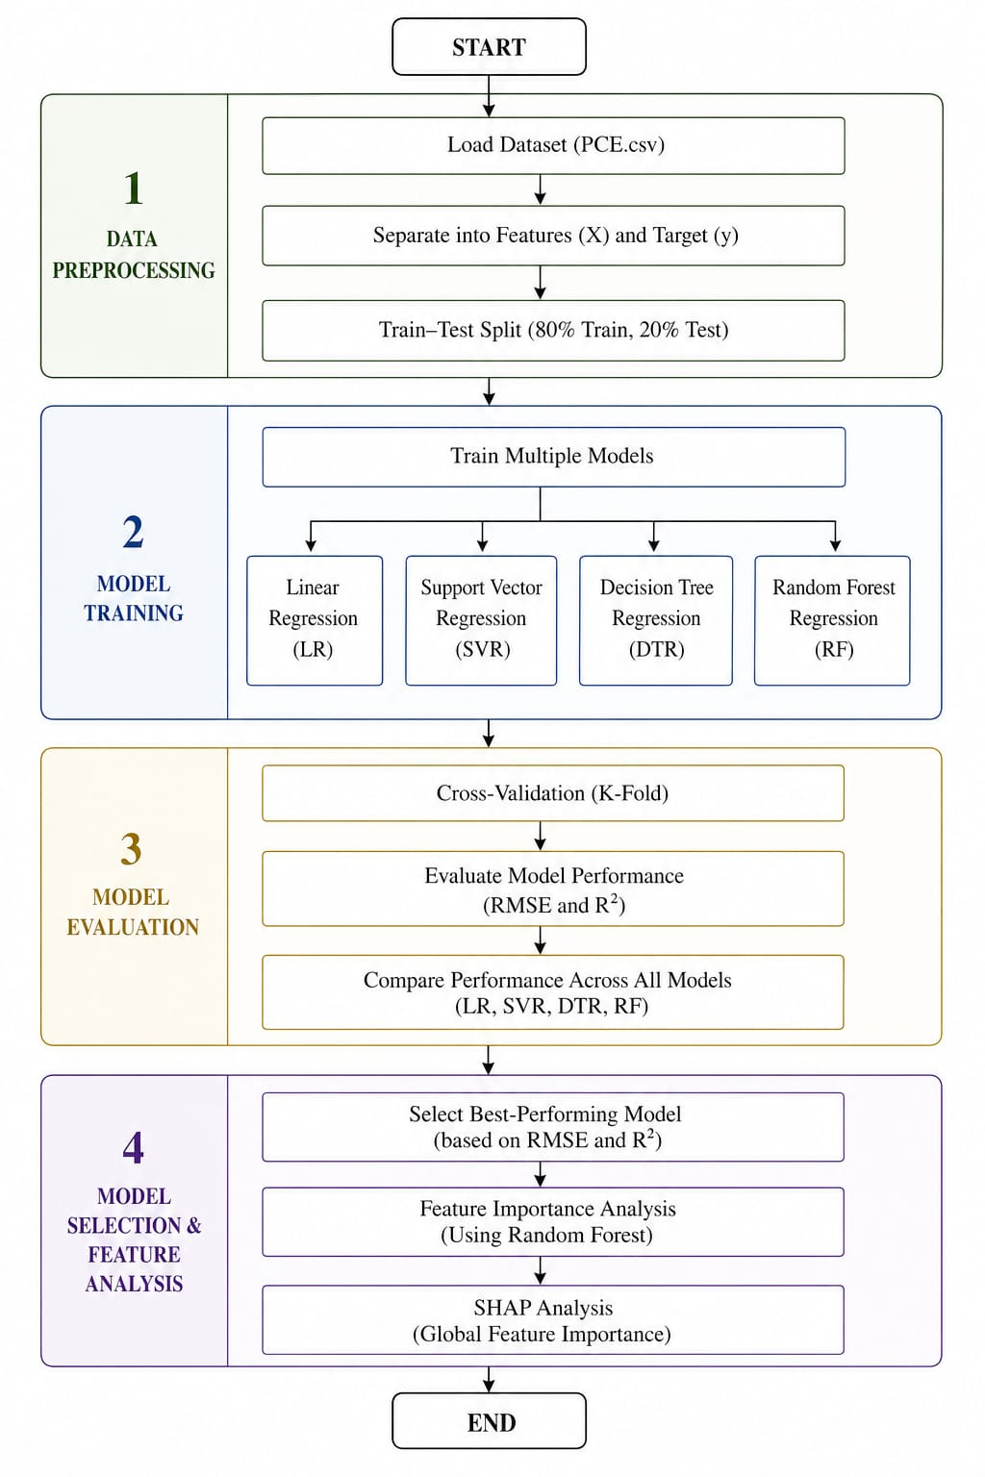
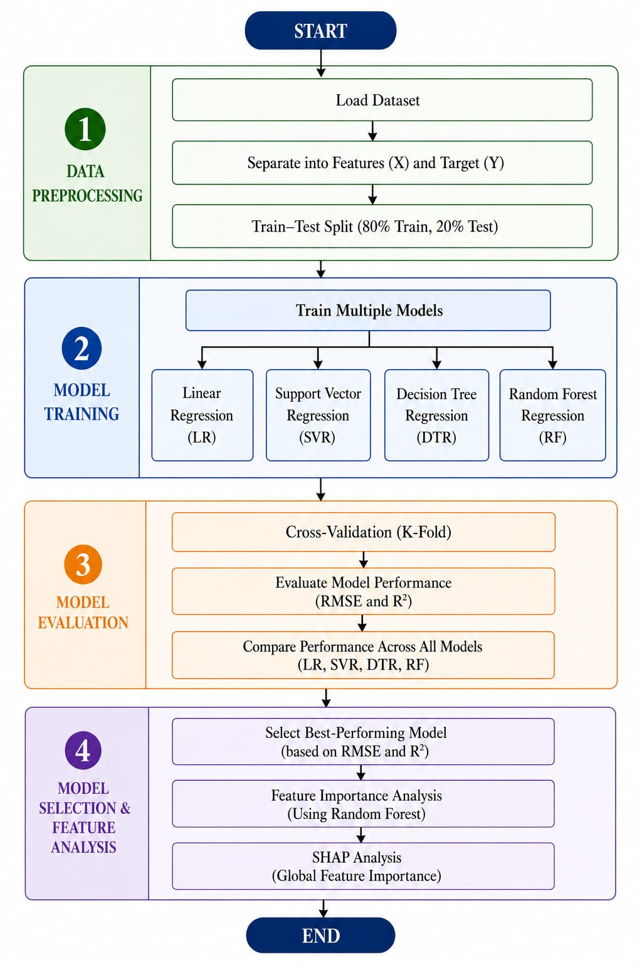

Slide 70
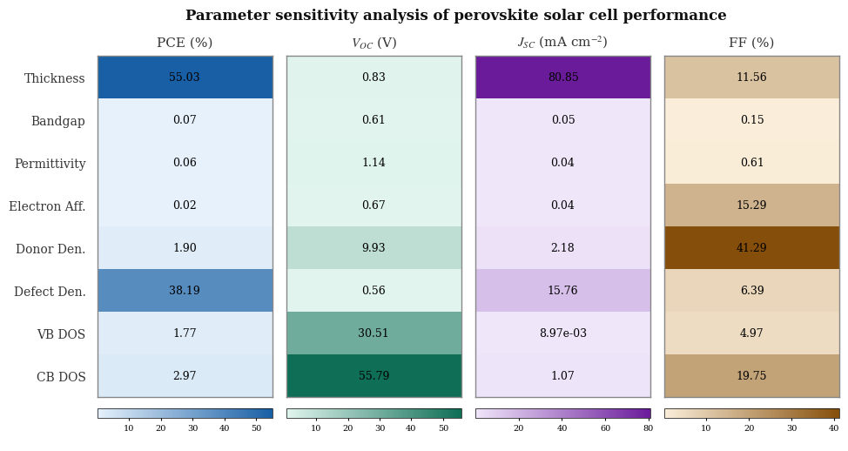

Slide 71
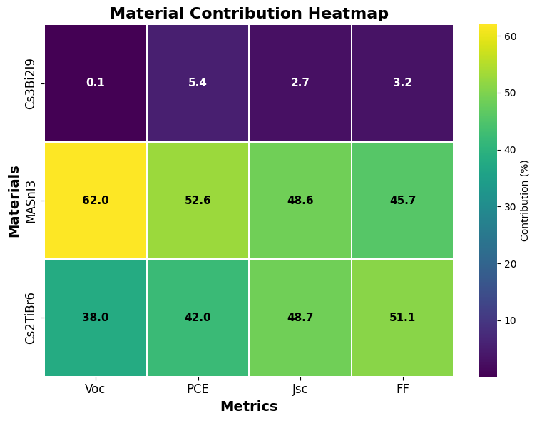

Slide 72
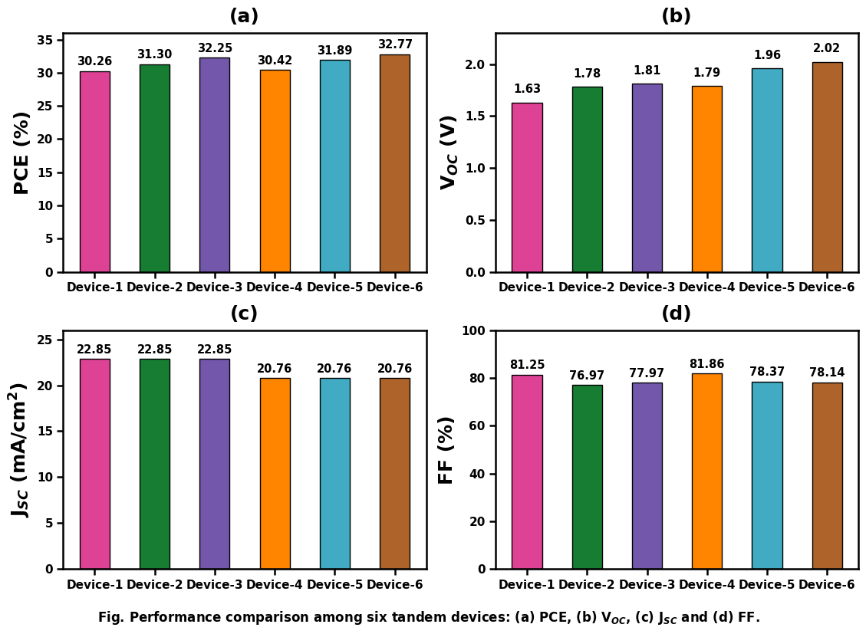

Slide 73
PCE (%)
V_{OC} ( V )
J_{SC} (mA/cm²)
FF (%)

Slide 74
PCE (%)
V_{OC} ( V )
J_{SC} (mA/cm²)
FF (%)
Cs₂TiBr₆
MASnI₃
Cs₃Bi₂I₉

Slide 75
PCE (%)
V_{OC} ( V )
J_{SC} (mA/cm²)
FF (%)
Thickness
Bandgap
Permitivitty
Electron aff.
Donar den.
Defect den.
VB DOS
CB DOS

Slide 76
PCE (%)
V_{OC} ( V )
J_{SC} (mA/cm²)
FF (%)

Slide 78
Light
Al
FTO
Top sub-cell
MASnI₃
Cs₃Bi₂I₉
Load
Filtered Light
Recombination Layer
ZnO:Al
i-ZnO
Bottom sub-cell
CdS
CZTSSe
V₂O₅
Au

Slide 79
Light
Al
FTO
Top sub-cell
MASnI₃
Cs₃Bi₂I₉
Load
Filtered Light
Recombination Layer
ZnO:Al
PCE= 32.77%
V_{OC} = 2.02 V
J_{SC} = 20.76 (mA/cm²)
FF = 78.14%
i-ZnO
Bottom sub-cell
CdS
CZTSSe
V₂O₅
Au

